Slide 1

Notes:
1

Slide 2

Role of Automation in Improving Boiling House Efficiency
Rashad Ehsan
GM(E & I)
Shakarganj Mills Limited

Slide 3
Expensive Automation ?
Sugar is being produced profitably without Automation
Highly Technically Skilled Staff is available with affordable cost
Hesitate to experiment themselves, Waiting for fruitful results

Slide 4
Benefits of Automation
Accurate Monitoring of Process Parameters
Efficient Control of Processes
On line Recording
Historical Trending

Slide 5
Benefits of Automation
Losses became apparent after automation and then can be eliminated
Helping to get desired results
Automation should pay for itself

Slide 6
Why Optimization of Boiling House
50 - 60 % steam on cane
70 % of Total Losses in Boiling House
Quality of Product
Reduced variations due to human error

Slide 7
Topics
Juice Stabilization System
Remelter Automation
Evaporator Automation
Refine melt clarifier Automation
Condensing System Automation
Batch Pan Automation
CV Pan Automation
VFD
Auto Bagging Machines

Slide 8
Juice Flow Stabilization
Raw Juice Flow Measurement
Raw Juice Tank Level
Heater Temperature Monitoring
pH of Clarifiers
Speed Regulation of chemicals at Clarifier
Milk of Lime Flow Control at Defecation
pH of Defecated Juice

Slide 9
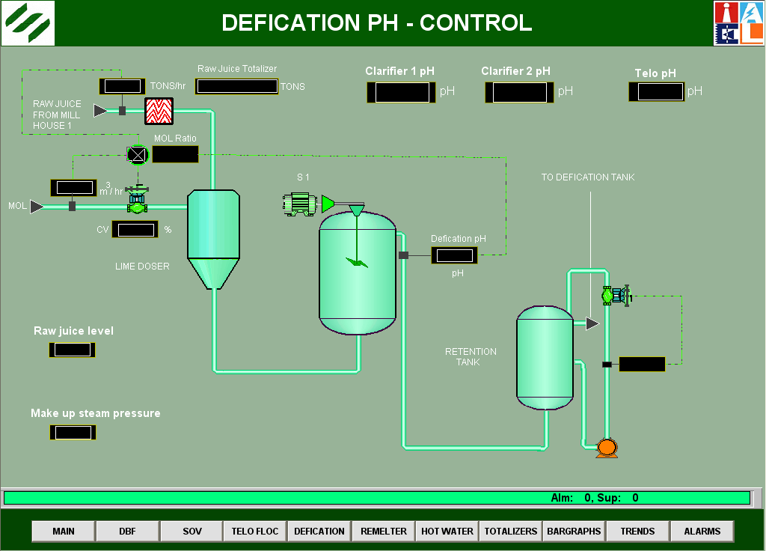

Slide 10
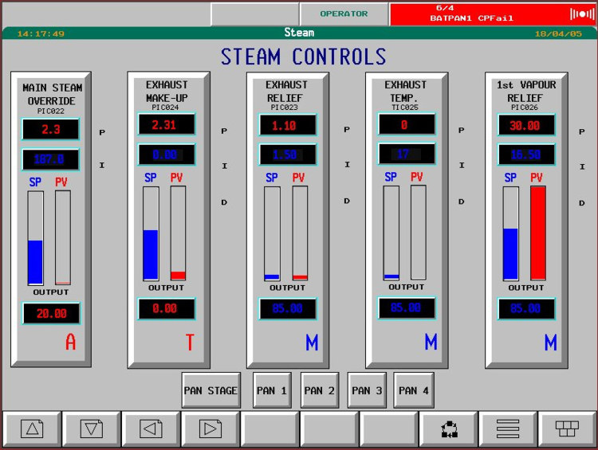

Slide 11
Benefits
Uniform Raw Juice Flow
Stable operation of Clarifier
Smooth Chemical dozing
Effective heating of Juice in heaters
Better setting at clarifier leading to improved quality of clear juice

Slide 12
Benefits
Reduction of losses by minimizing recirculation juice in form of filtrate
Low brix of MOL cause more water to be evaporated at Evaporator Station so steam usage will be increased.
Smooth and Reduced Chemical Consumption

Slide 13
Remelter Automation
Remelter Brix Control
Remelter Temperature Control
Level Indications
Benefit
Steam reduction up to 1 % due to smooth operation

Slide 14
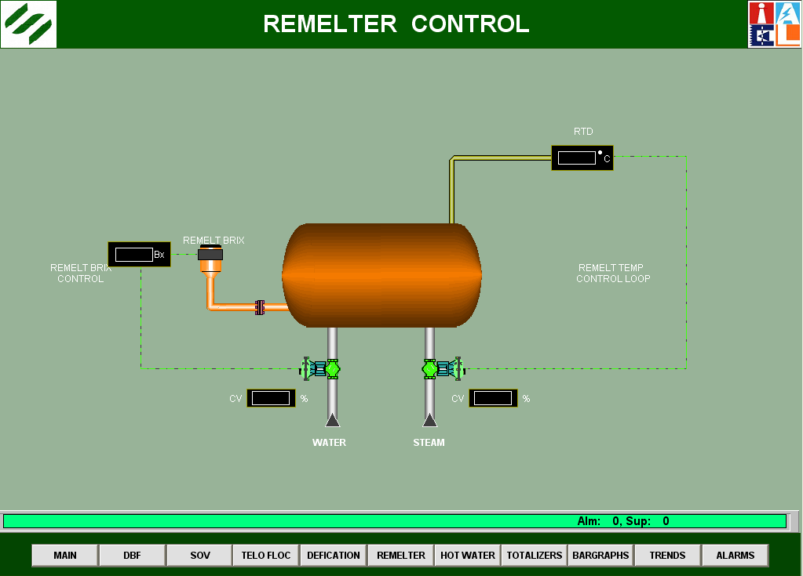

Slide 15
Evaporator Automation
Temperature of vapor space and calandrias
Pressure / Vacuum of bodies and calandrias
Vacuum in the last body
Pressure and temperature of exhaust steam
Level of Juice in each body
Brix of syrup
Flow of condensates from calandrias

Slide 16
Evaporator Automation
Regulated feed to each vessel
Maintain level in bodies
Brix control
Consistent high syrup brix
Less scale formation due to even juice level
Degree of superheat does not exceed 25 – 30C
Superheated steam has poor heat transfer rate

Slide 17
Evaporator Automation
Level in Evaporator bodies
Vessel 1 35 – 40 %
Vessel 2 25 %
Vessel 3 & 4 20 %

Slide 18
Evaporator Automation
In case low or high juice levels, the circulation is affected and rate of evaporation lowered and chance of entrainment increases
Vacuum in last body less than 625 – 650 mm

Slide 19
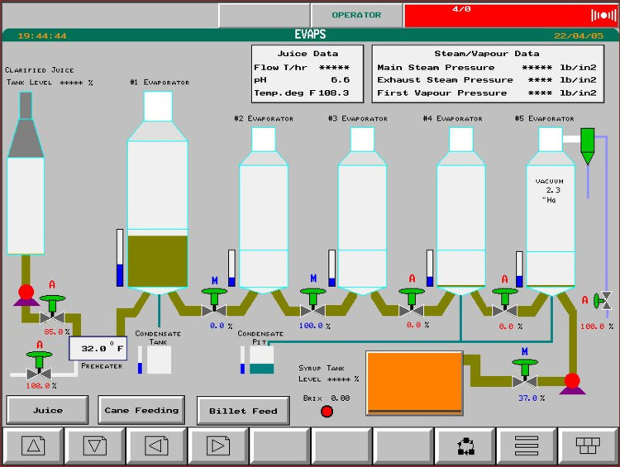

Slide 20
Refine Melt Clarification
Deep Bed Filters
Talo Clarifier
Benefits
Better Color Removal
Efficient Use of Chemicals
Consistant Results

Slide 21


Slide 22
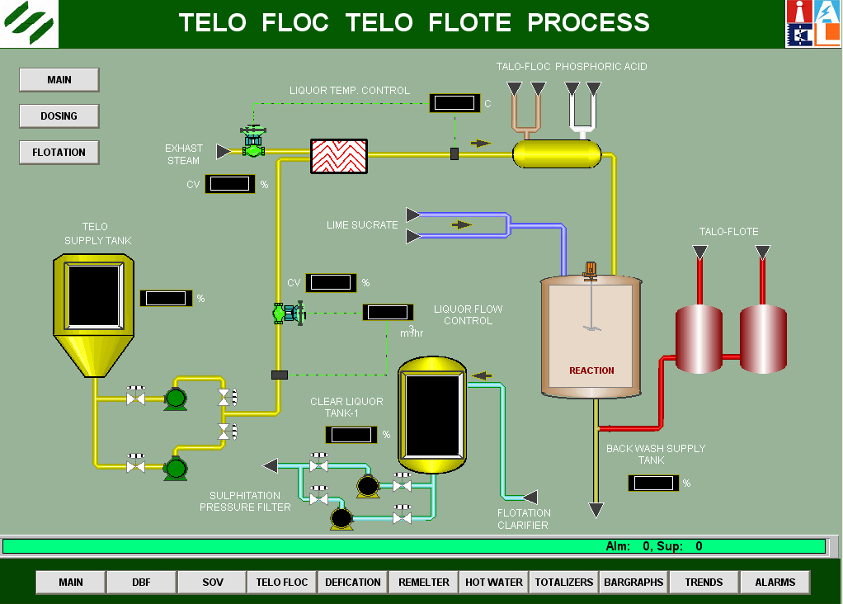

Slide 23
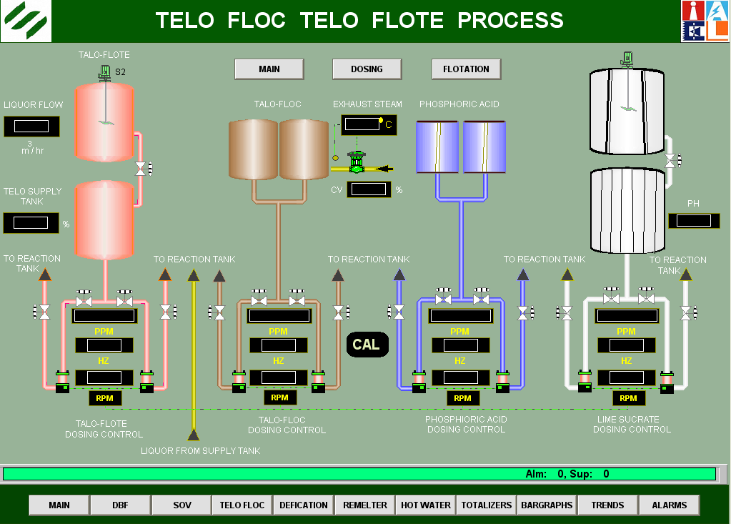

Slide 24
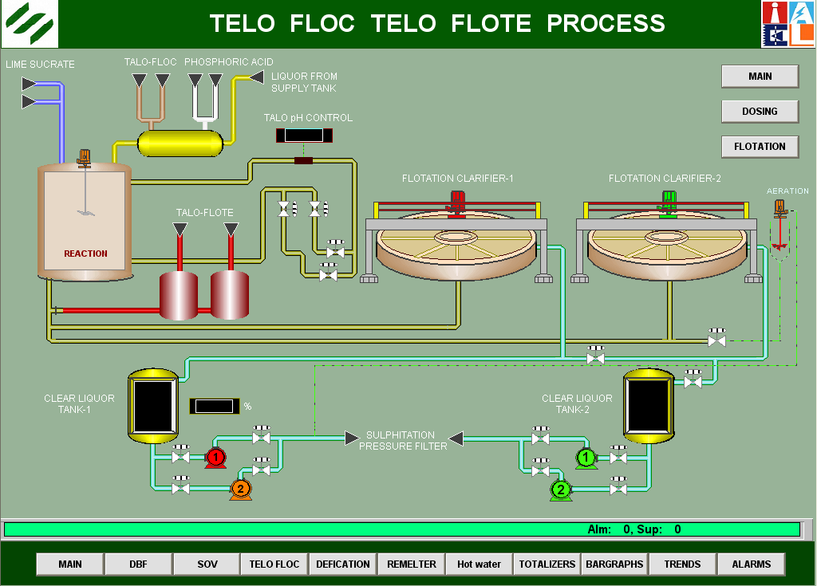

Slide 25
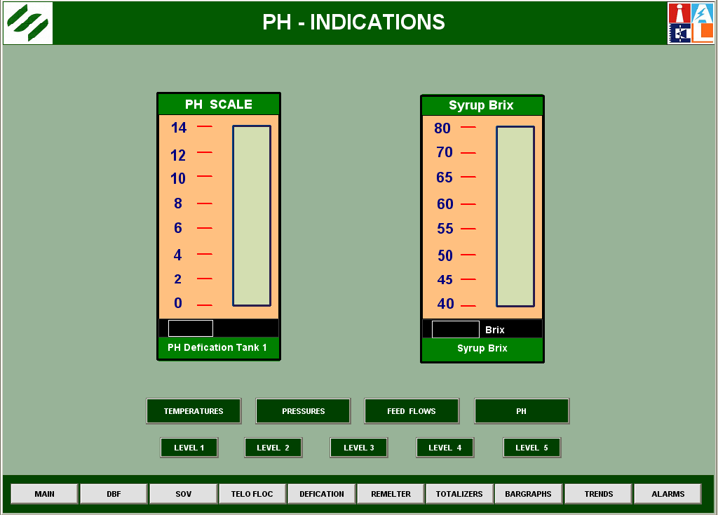

Slide 26
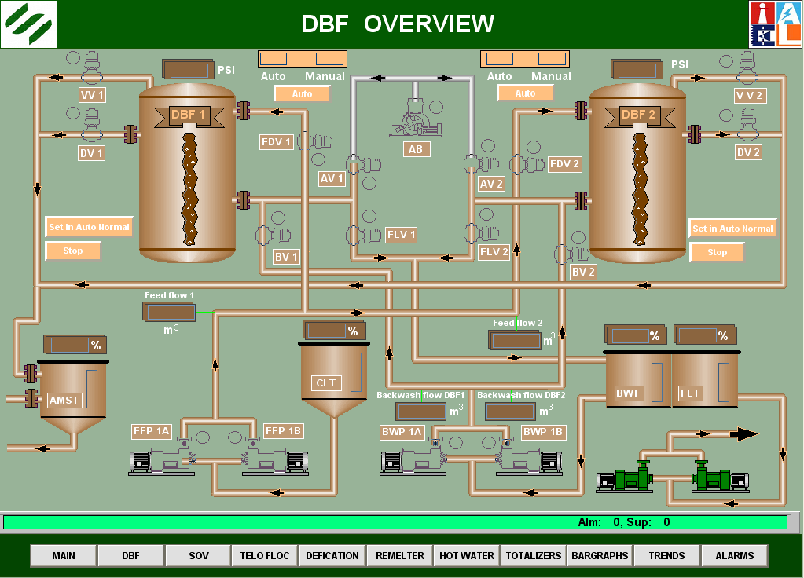

Slide 27
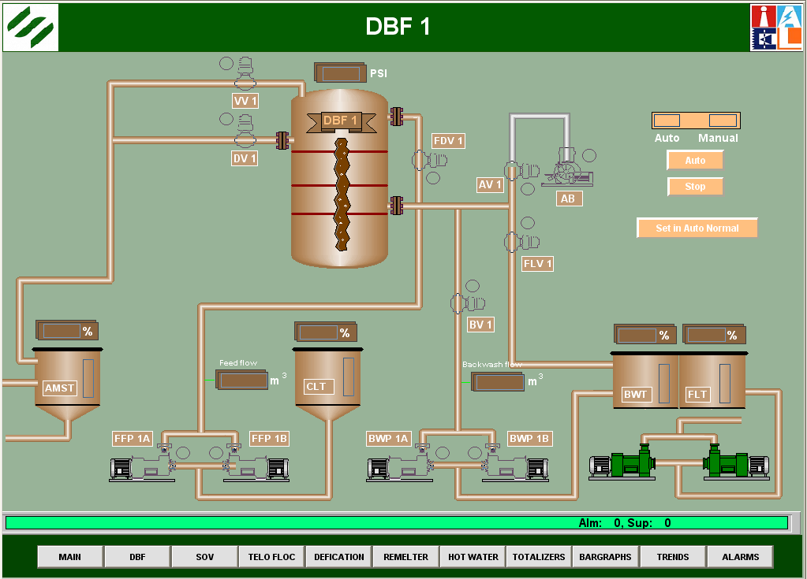

Slide 28
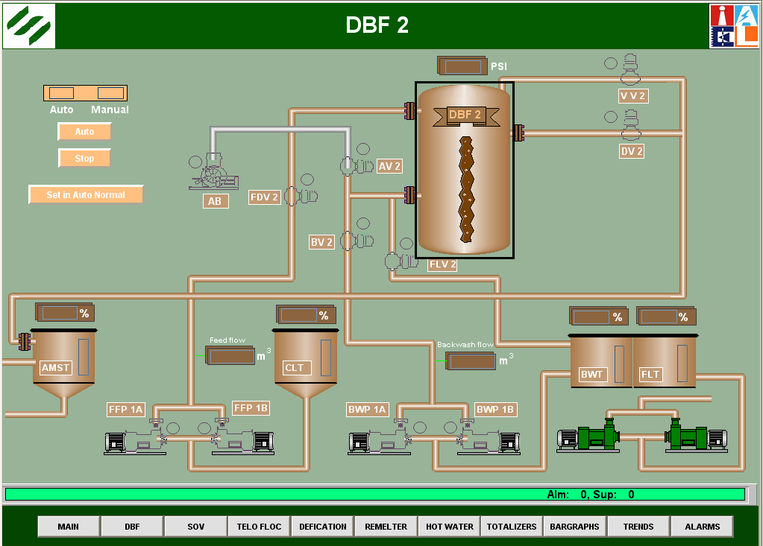

Slide 29
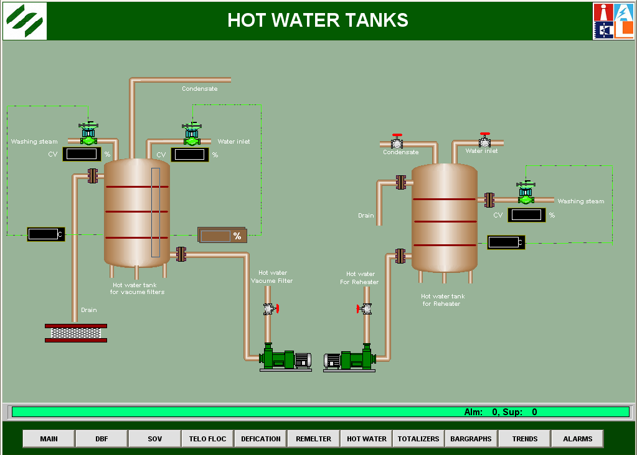

Slide 30
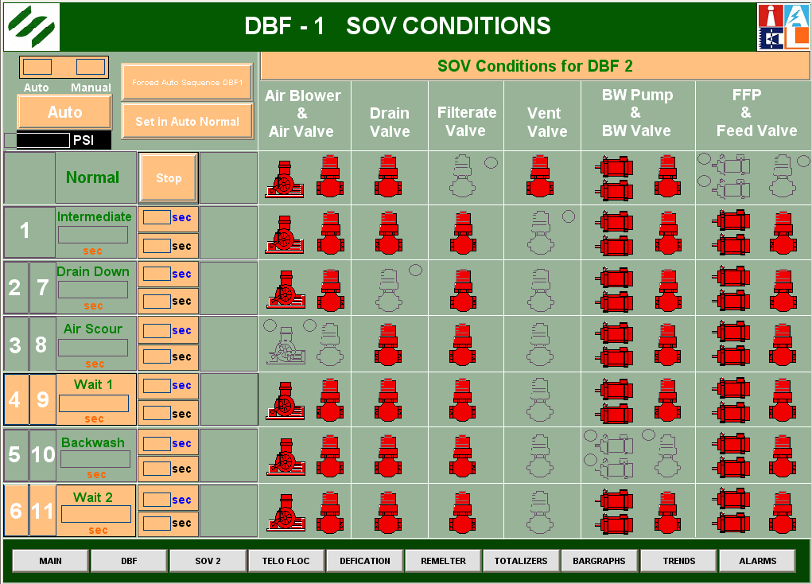

Slide 31
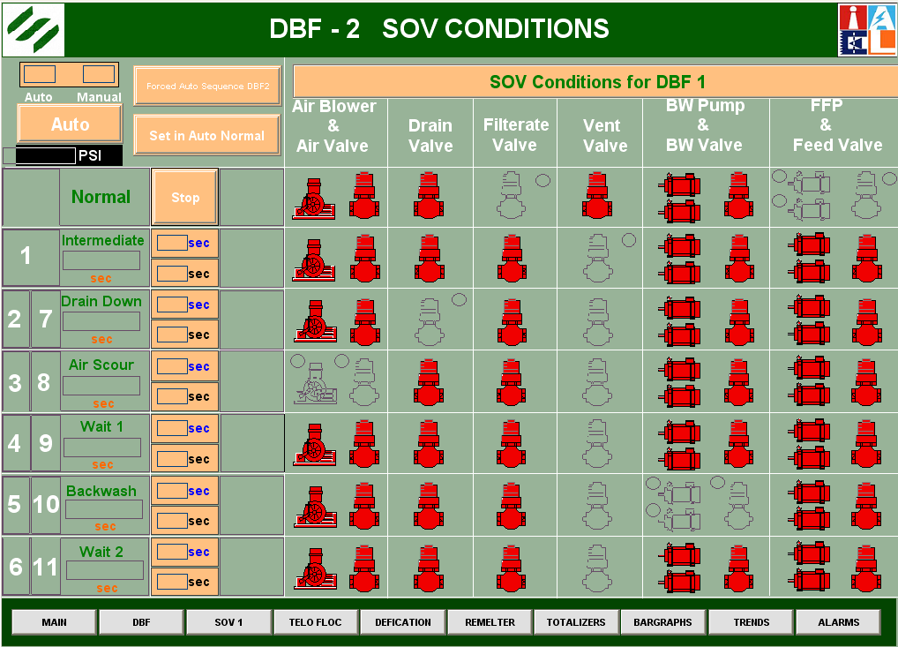

Slide 32
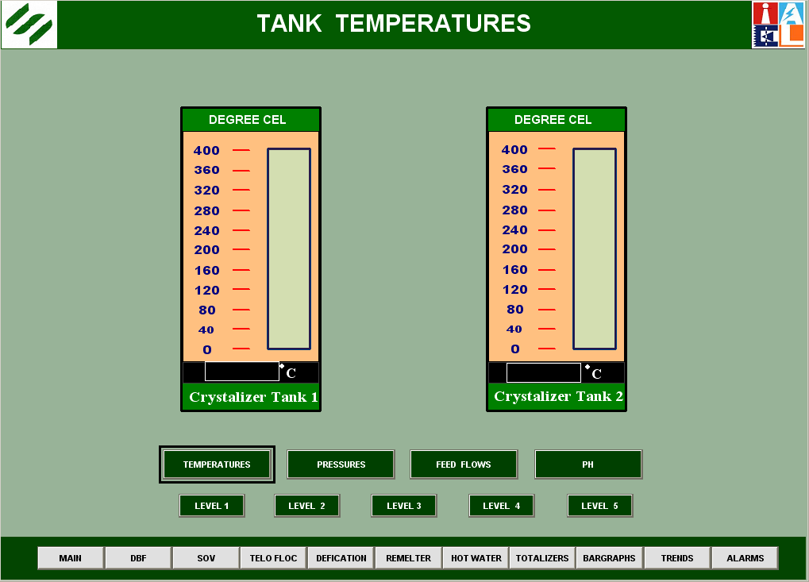

Slide 33
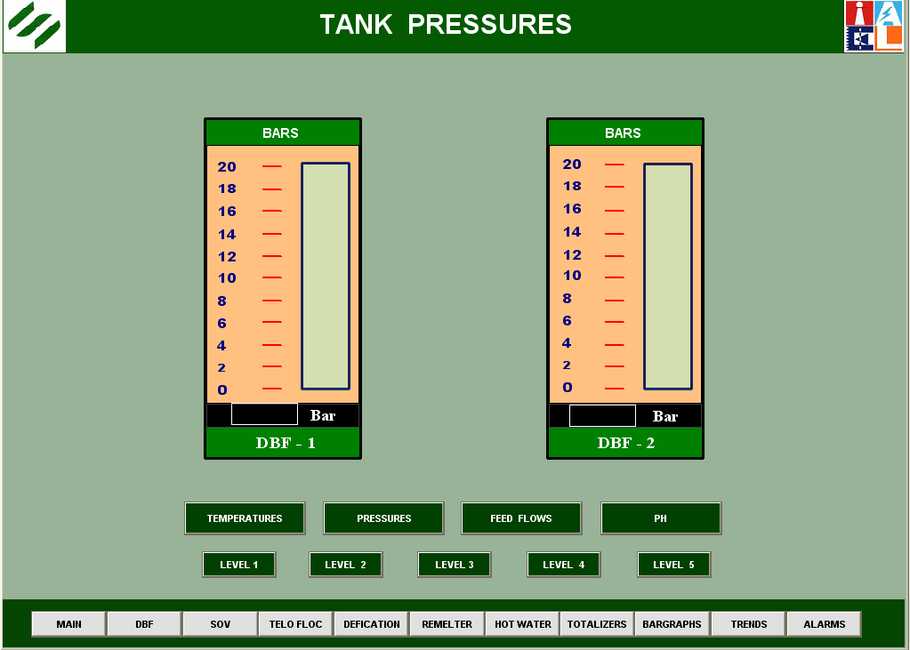

Slide 34
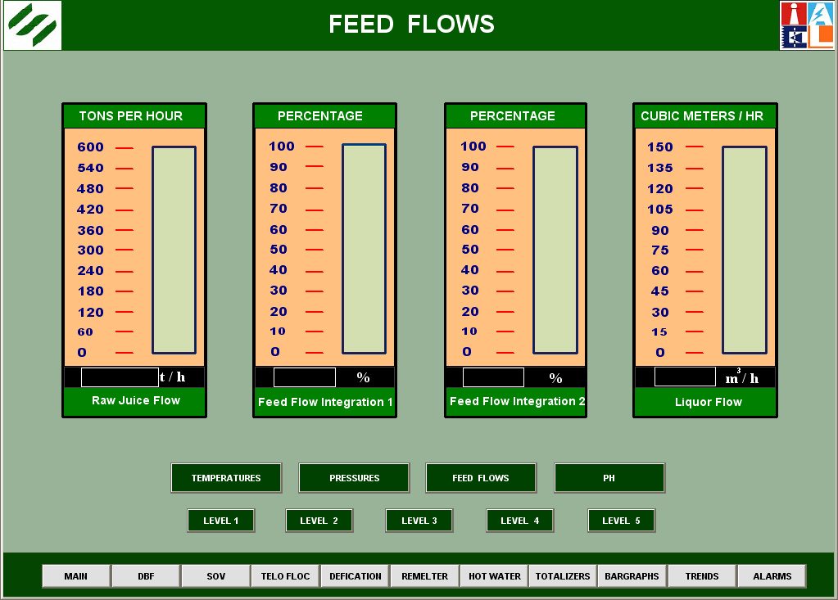

Slide 35
Condensing System Automation
Conventional System
In case of variable Load :
Huge quantity of water circulation
High Electricity Consumption
Large number of equipment installation( Pumps, Motors)

Slide 36
Condensing System Automation
Modern Condensing System
Economical use of water
Energy reduction without effecting efficiency of condenser( i.e. almost 50 %)
Two Types
Nozzle Governing System using
High Pressure Water controls Nozzle Operations
Single Entry Condensers
Nozzles being controlled by pneumatic pressure
No need of Spray Pumps

Slide 37
Why Batch Pan Automation
The boiling of Massecuite in Batch Pan is very critical operation.
Because the super saturation of boiling liquid inside the pan should be maintained within a very narrow range.
Ineffectiveness of operator to do so will leads to extra water drink to dissolve false grain.

Slide 38
Batch Pan Automation
This will increase steam/vapor requirements
The curing time will also increased
For energy conservation such a laxity is not affordable.
The Automation of batch pan in inevitable to :
To maintain massecuite inside the Boiling Pan at a super saturation , in matastable zone.

Slide 39
Batch Pan Automation
The measurement of brix of pan
Level of massecuite inside the pan monitored continuously
Feed liquor is controlled automatically.
Clalendria steam pressure is monitored and steam flow to pan is regulated.

Slide 40
Batch Pan Automation
The operations like:
Selection of feed liquor,
seed slurry feeding,
Control of Vacuum,
Vacuum breaking,
Pan washing, Opening and closing of discharge valve can also be automated.

Slide 41
Batch Pan Automation
Disturbances like
No juice available
Mingler is full
Vacuum Breakdown
Can be handled well in automation
Leave 51 steps use one step automation

Slide 42
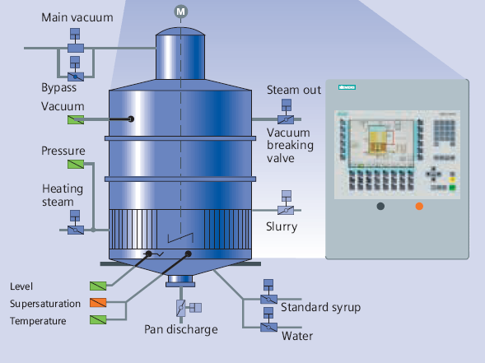

Slide 43
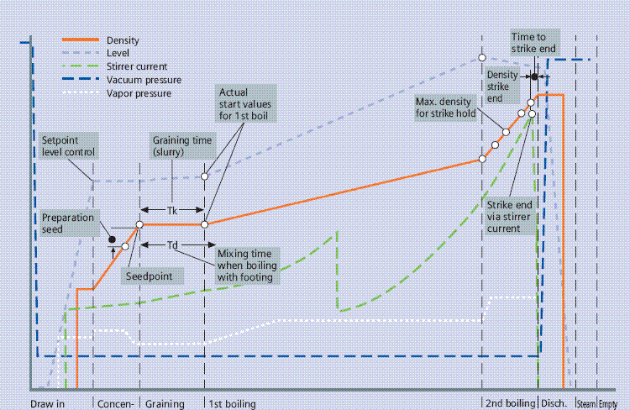

Slide 44
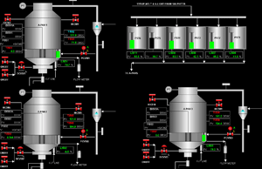

Slide 45
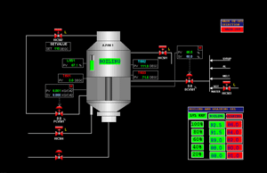

Slide 46
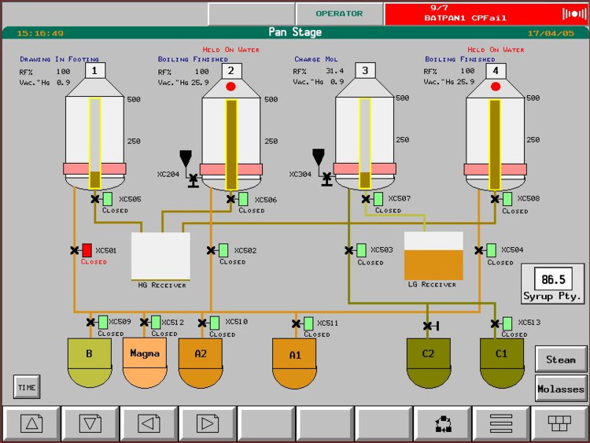

Slide 47
Batch Pan Automation Benefits
Reduction of boiling time 20 – 30 %
Reduction of energy(steam, vacuum) 20 - 30 %
Reduction of sucrose in final molasses 1 – 2 %

Slide 48
Benefits
Maximum amount of desired grain
Minimum contents of fine grain
Narrow range of crystal size
Easy operation even by not fully trained operators

Slide 49
Continuous Vacuum Pan Automation
To monitor conductivity in each compartment
To control liquor feed into each compartment.
To monitor and control total liquor feed rate to the pan
To control the seed magma feed to the pan
To monitor calendria pressure
To control steam flow to the pan
To control massecuite discharge w.r.t. level in last compartment.

Slide 50
Continuous Vacuum Pan Automation
Brix Control
Vacuum Control
Steam Pressure Control
Maccecuite Flow Control
Seed Flow Control
Purity Control

Slide 51
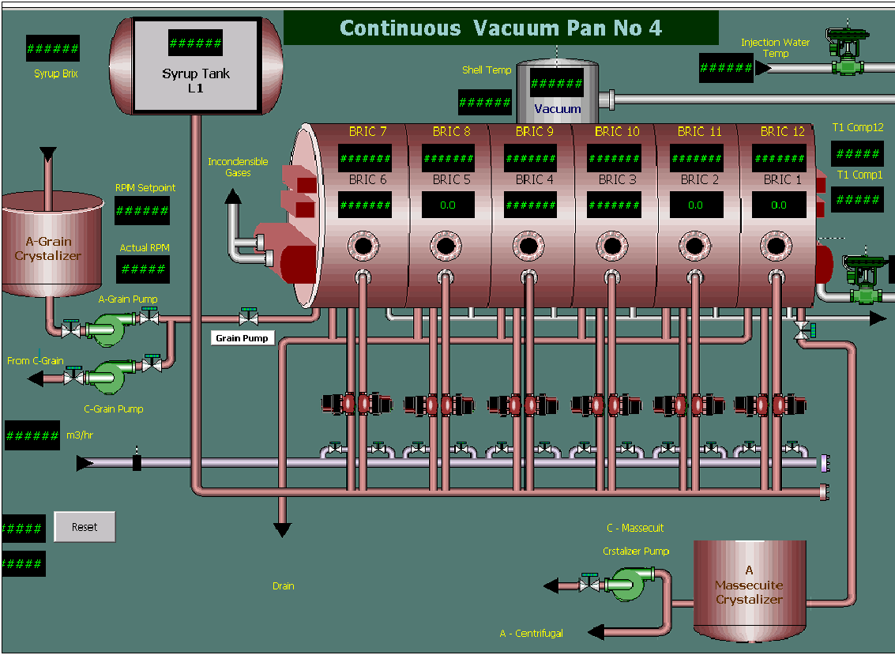

Slide 52
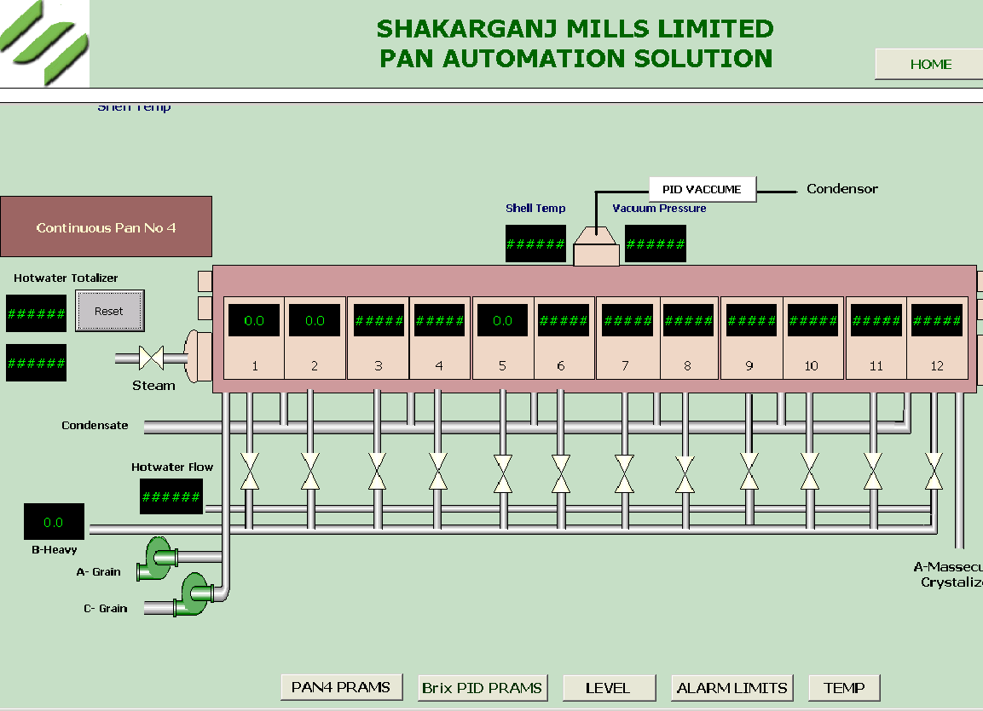

Slide 53
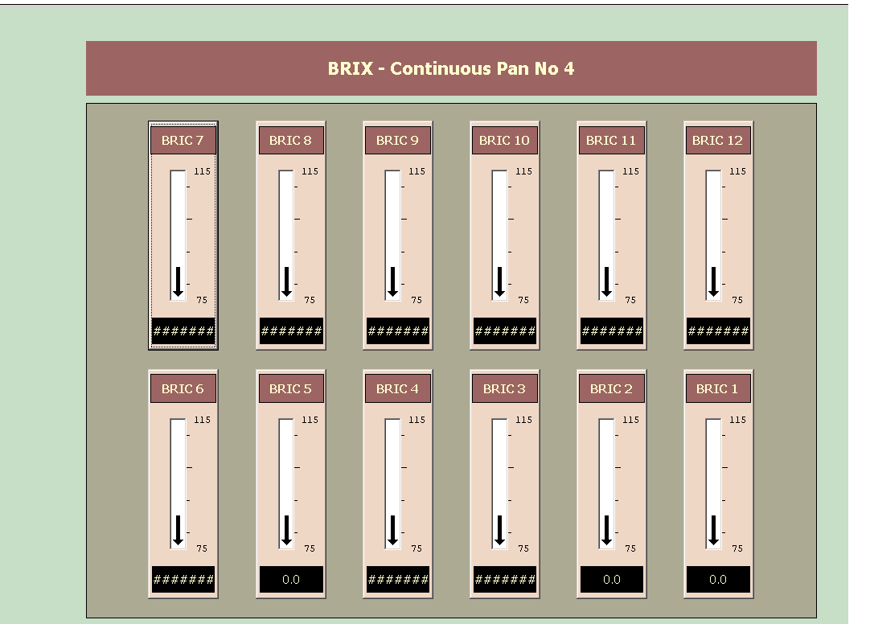

Slide 54
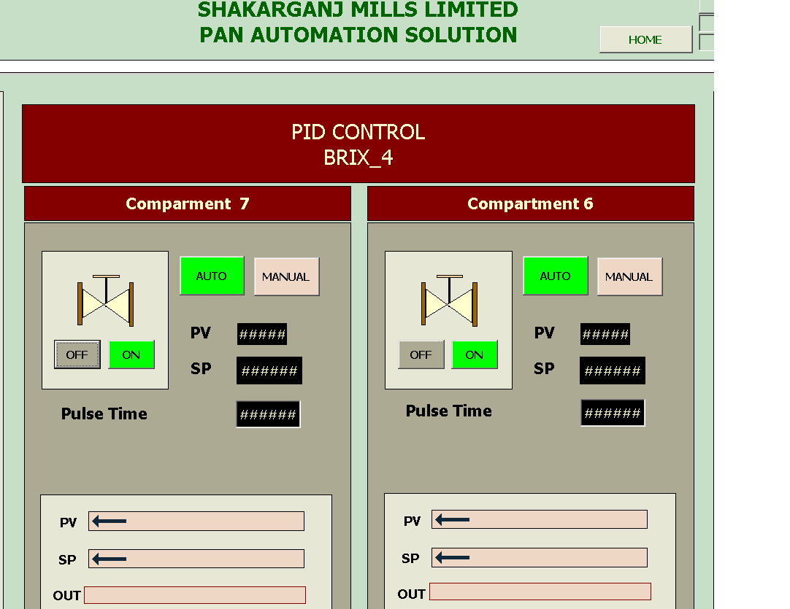

Slide 55
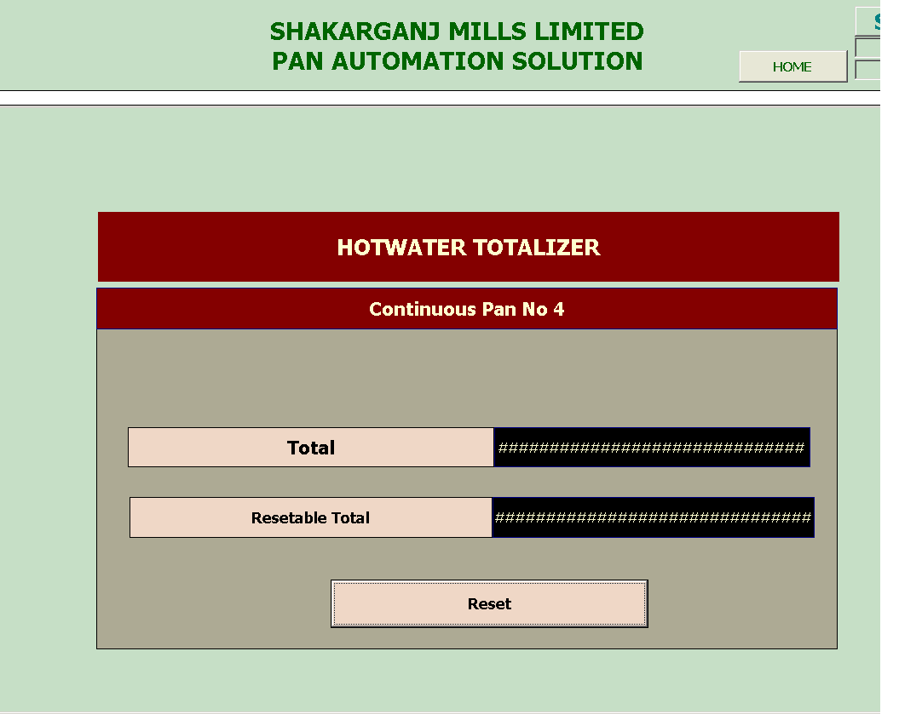

Slide 56
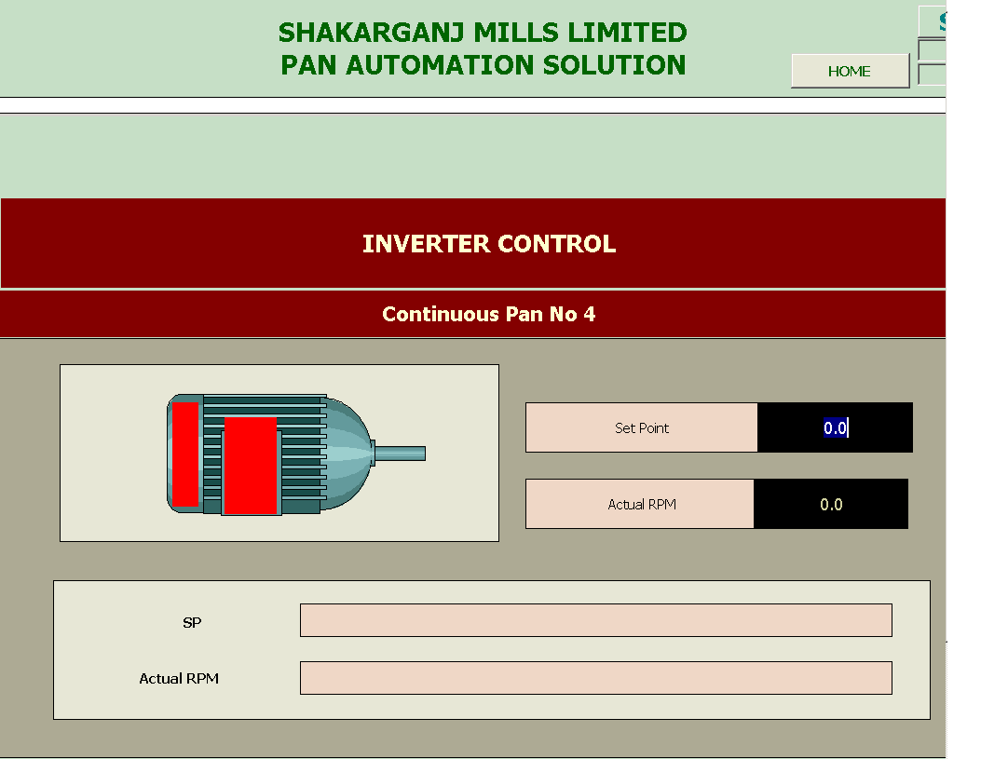

Slide 57
Benefits
Pan Floor capacity enhancement
Steam Economy
Sugar Quality

Slide 58
Variable Speed Drives
Variable Loading of Process House
Pumps runs on reduced capacities by throttling the valves.
VFD can reduces electrical energy consumption at least by 30%

Slide 59
Recommend Drives
Raw Juice Pumping
Air compressors
Sulfur Burner Air Compressors
Muddy Juice and Filtrate Pumps
Clear Juice Pumps
Hot and Cold Air Blowers

Slide 60
Recommend Drives
Dust Catcher blowers
Sugar Elevators
Vacuum Filter Condenser water pumps
Defecated Juice Pumps

Slide 61
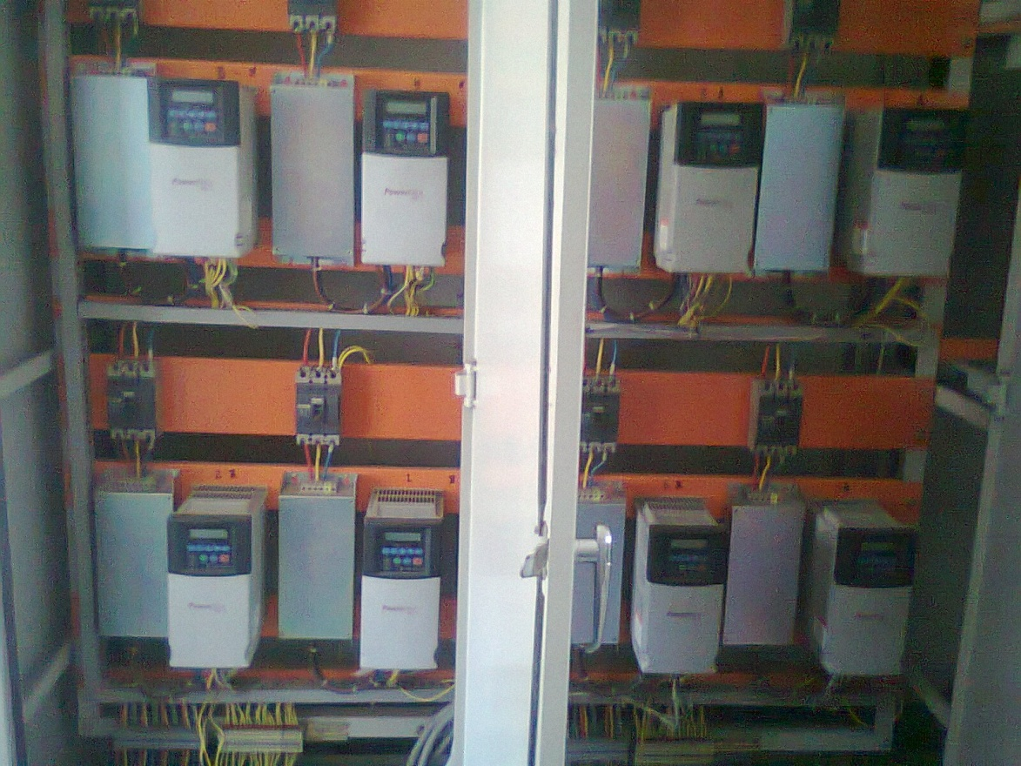

Slide 62
Auto Bagging Machine
Gravity Flow Measurement Technique
Sugar Bin Level
Speed of Bagging
Accuracy of Weighing

Slide 63
Auto Bagging Machine
Single Chute Bagging Machine
Speed Problem
Accuracy Problem
Durability
Double Chute Bagging Machine
Speed 16 – 18 bags per minute
Accuracy 20 gram
Standby Arrangement

Slide 64
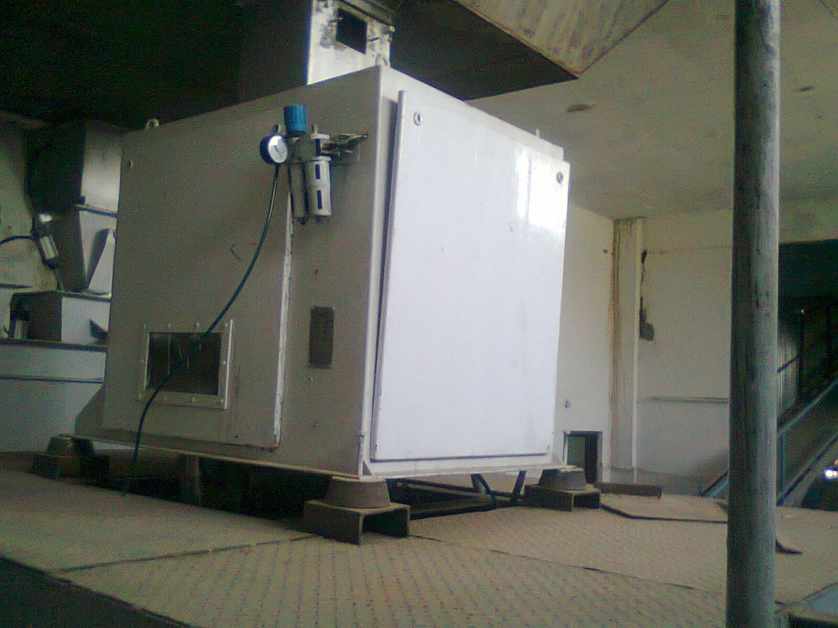

Slide 65
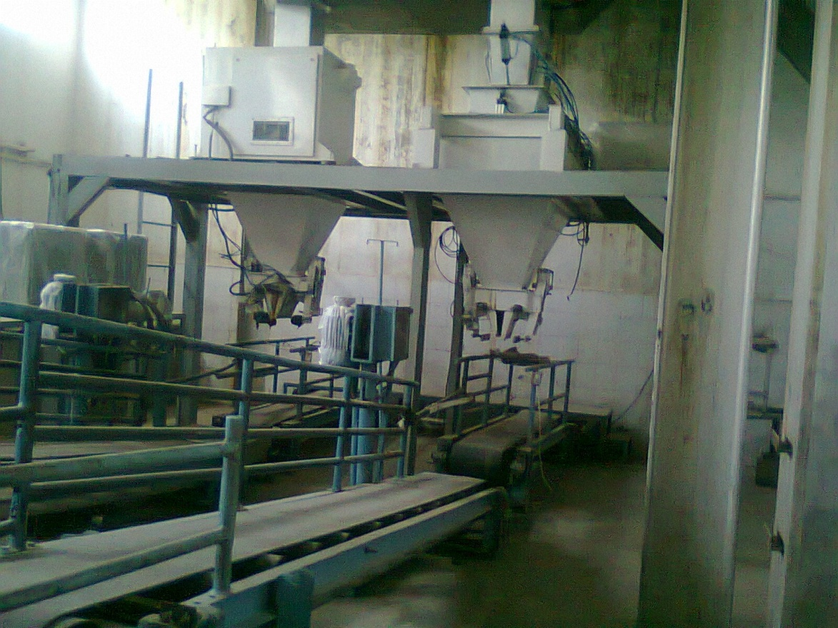

Slide 66
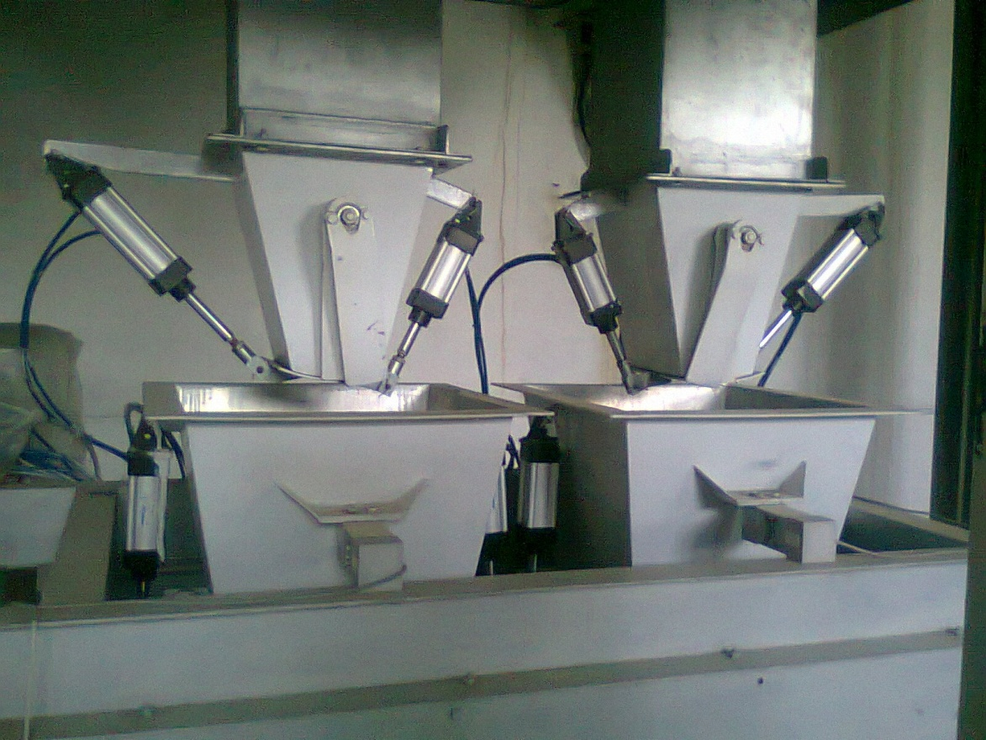

Slide 67
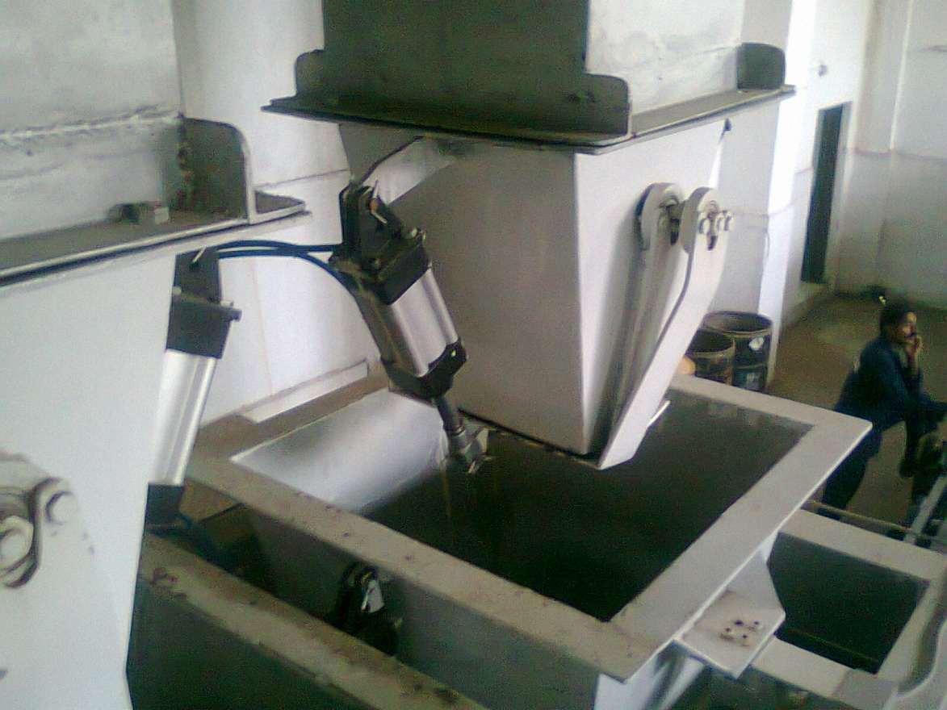

Slide 68
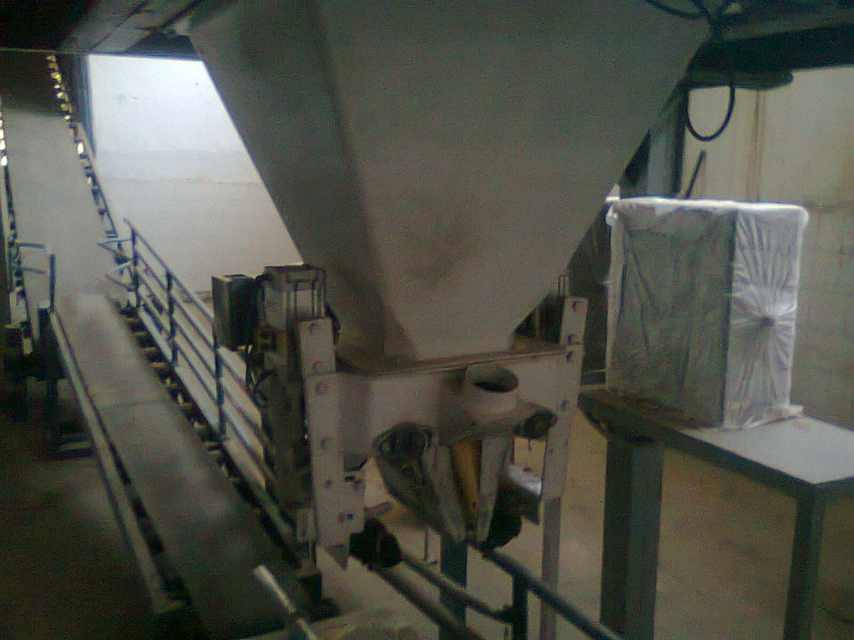

Slide 69
Thanks
Notes:
69

