Slide 1

Topic : Prospects & Potential of New Promising Sugar Cane Varieties as Possible Replacement
PSST Agriculture Workshop 2012
Serena hotel, Faisalabad
Presented by :
Rana Muhammad Asghar Khan
General Manager Cane
Colony Sugar Mills, Phalia
30 June, 2012

Slide 2
Area of Focus
The area of focus in my presentation is right bank of River Chenab.
There are 9 Sugar Mills present in this area. There names are as under:
Colony sugar Mill
Shahtaj Sugar Mill
Noon Sugar Mill
National Sugar Mill
Kohinoor Sugar Mill
Abdullah II Sugar Mill
Chishtia Sugar Mill
Shakarganj Sugar Mill
Safina Sugar Mill

Slide 3
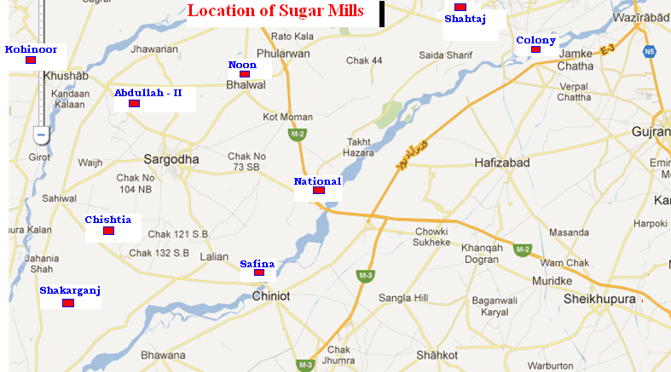

Slide 4
History
The region under discussion mainly comprising of district Sargodha and Mandi Bahauddin & part of District Khushab and Chiniot.
This region has past history of cultivation of inferior unapproved varieties.
CO-1148 was extensively grown on large area during 90’s.
In late 90’s CO-1148 developed red rot disease, so the growers shifted to the cultivation of COJ-84.
COJ-84 unfortunately also developed red rot disease in 2003-04.
The growers this time were fortunate enough to get seed of variety S-95 US-241 (SPF-238) from the outfield trials and Govt Agriculture farms.
Continue…..

Slide 5
History
S 95 US- 241 suited to growers needs became extremely popular as S-95 in District Mandi Bahaudin and Richman in District Sargodha. Ironically permanent number SPF – 238 was also assigned.
It replaced COJ-84 but adversely affected the % cultivation of other better varieties like CP-72-2086, CP-77-400, HSF 240 & CP-43-33 available at that time
By year 2005-06 this varieties had occupied over 80% area in Sargodha district & 40-50% in Mandi Bahauddin District .
The 40-50% percentage of this variety in Mandi Bahauddin District which was due to cane development activities continued by Shah Taj and Phalia Sugar Mills.
Cane crushing seasons 2005-06 to 2009-10 were the worst as the growers continued to grow this variety due to high rates paid by the mills irrespective of any variety.
Continue…..

Slide 6
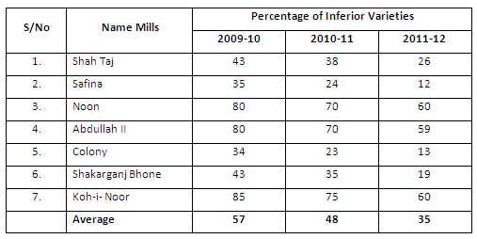
History
The distribution of SPF-238 & other inferior varieties during the last 3 years is as under:
Continue…..

Slide 7
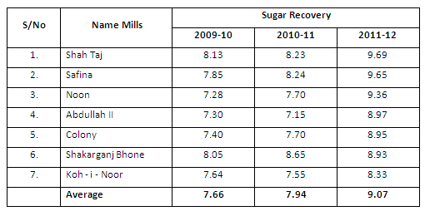
History
The average sugar recovery table given below displays the values obtained by the mills of this region during the period 2009-10 to 2011-12.
Continue…..

Slide 8
History
The above figures clearly indicate that there is a definite correlation between the percentage area of inferior varieties and sugar recovery.
As the overall area under inferior varieties has decreased from 57% to 35%, the average sugar recovery has increased from 7.66 to 9.07.
Season 2011-12 can be compared to 2003-04.
Overall percentage of inferior varieties was almost the same.
Better average recovery during 2011-12 (9.07) compared to 2003-04 (8.91) can be attributed to comparatively better available sugar cane varieties and procurement of cane of inferior varieties on the basis of sugar contents.

Slide 9
Present Scenario
From 2010-11 onwards forced by lesser sugar cane prices there has been a renewed awakening to eradicate this variety.
Every mills is endeavoring to discontinue its cultivation by limiting the purchases and not offering any additional price.
It has paid dividends and the overall cultivated area of this variety is likely to come down to less than 20% during 2012-13.
For the first time, encouraged by the additional rates offered by mills on better varieties, the growers have made up their mind to part with this variety and are looking for the cultivation of better sucrose varieties.
Whatever ratoon crop is left is likely to be uprooted at the beginning of 2012-13 crushing season.
Thus, percentage acreage of SPF-238 is likely to come down below 10% by the end of 2012-13 season provided every mill continues its present cane procurement policy with the ultimate aim of its complete eradication.

Slide 10
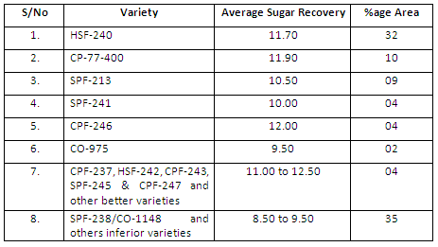
Present Varietal Distribution
There are many sugar cane varieties available at present. Most of these have been approved / registered. The average varietal composition at present in our region is as under :
Continue…..

Slide 11
Present Varietal Distribution
The growers over the past decade paid little attention towards the cultivation of these varieties.
The existence of better varieties continued in limited areas only due to cane development activities carried out by a few sugar mills on limited scale.
It is quite evident that despite of a large number of approved better sucrose varieties available at present, the percentage of most of these is exceptionally low.
Only HSF-240 occupies the bulk of area under better varieties followed by CP-77-400 and SPF 213.
Despite of certain limitations of most of the available varieties, I still am of the opinion that these varieties have not been given fair chance by the growers before rejecting them.
Continue…..

Slide 12
Present Varietal Distribution
We fully understand that better varieties require high input level and adaptation of better cane production technology for achieving the desire results.
Unfortunately these varieties have always been compared with SPF 238 by growers at low input levels where SPF out matches all.
Despite unjustified comparison most of the better varieties have certain inherent limitations which tend to discourage growers from large scale cultivation.
Continue…..

Slide 13
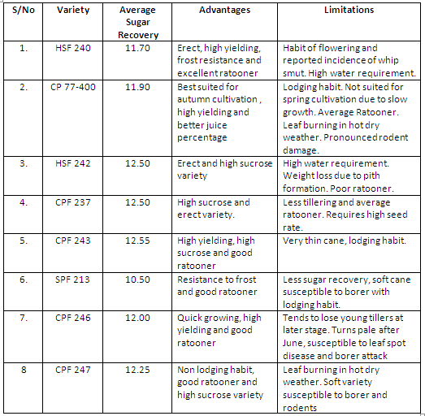
Present Varietal Distribution
The table below highlights the salient features and associated limitations of all the approved varieties.
Continue…..

Slide 14
Replacement of SPF-238
The area under SPF-238 will come down below 10% by the season 2013-14.
Naturally the growers will be looking for the replacement varieties which are best suited to them at least in terms of high yield and good ratooning ability.
As reported earlier there is little chance of growers replacing SPF-238 with existing approved varieties. HSF-240 is perhaps the only exception.
The common grower is likely to go for other inferior and average varieties having better yield potential both as plant and ratoon crop.
Unfortunately a number of sugar cane varieties have emerged on the scene. As a natural consequence other inferior/average mediocre sugar cane varieties only comparable in quality to SPF-238 may fill in the gap.
Thus the advantage to be gained due to elimination of SPF-238 can very easily be offset by the cultivation of varieties of the same calibre.
Continue…..

Slide 15
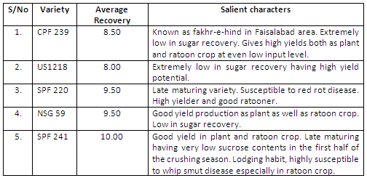
Replacement of SPF-238
Extreme care is therefore required to keep the spread of the following sugar cane varieties having all the favorable characters best suited to grower’s desire, under check.
Continue…..

Slide 16
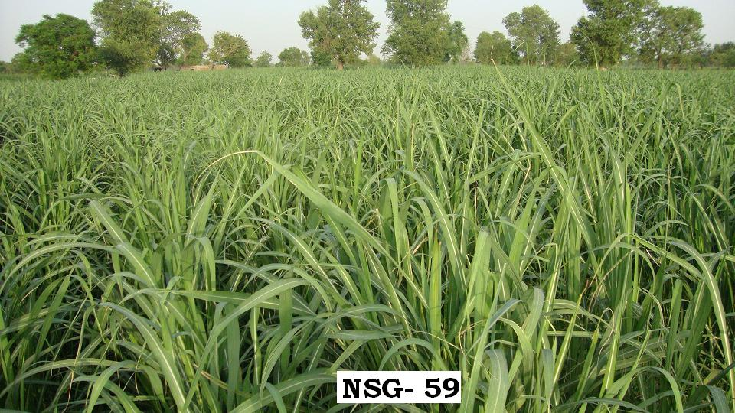
Unchecked Spread to be Discouraged
Continue…..

Slide 17
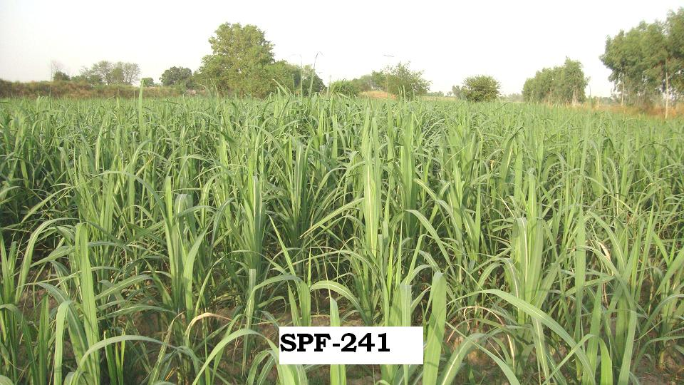
Unchecked Spread to be Discouraged
Continue…..

Slide 18
Caution Required on Unchecked Spread
Percentage area of NSG 59 and SPF 241 in this region has increased during the past year.
The growers are cultivating these as improved varieties. The same trend has been observed during spring 2012 cultivation season too.
Both of the above varieties are high yielding. However there is question mark on their sugar contents.
SPF 241 is late maturing and gives low recovery till January besides its susceptibility to whip smut disease. Afterwards it improves and records better recovery from February to April.
The qualitative analyses of NSG 59 are not encouraging at all as its sugar recovery seldom goes beyond 9%.
CPF-239 is a highly undesirable variety with sugar contents comparable to SPF 238 at the most.
Extreme care is therefore required in keeping the area of such varieties under control.

Slide 19
Future Strategy and Prospects
It has been discussed earlier that from all the available high sucrose approved varieties available at present, only HSF 240 has been liked by growers.
This variety despite of many beneficial characters has its own limitations as it requires high water intake besides having the tendency of flowering.
Of late incidence of whip smut has been reported especially on ratoon crop which is a risky phenomenon as 2 to 3 ratoons are usually kept.
Furthermore the cultivation of single variety is not at all advisable.
It is therefore quite pertinent that we must look for at least two or three potential varieties capable of replacing the existing ones.
These must possess characters which are to growers liking besides having desirable features like better sugar recovery and resistance to diseases.

Slide 20
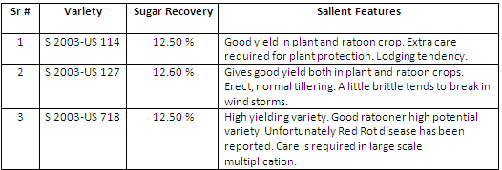
Potential Sugar Cane Varieties for Coming Years
There are a number of potential sugar cane varieties going through different trials.
From 2010 onwards these new upcoming varieties have been recommended by Sugar Cane Research Institute Faisalabad for out field trials.
The varieties show tremendous potential on the basis of studies carried out during the past two years.
The details gathered so far are tabulated below:
Continue…..

Slide 21
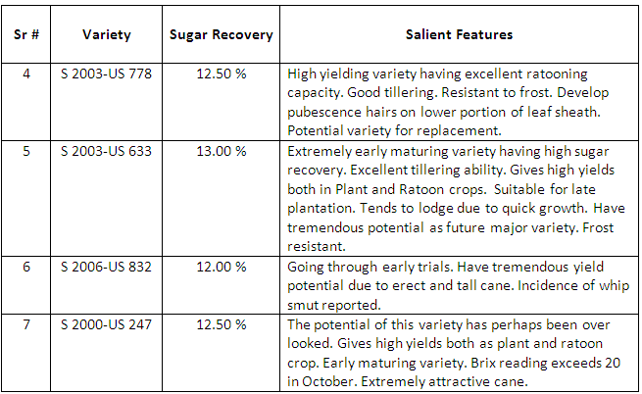
Potential Sugar Cane Varieties for Coming Years

Slide 22
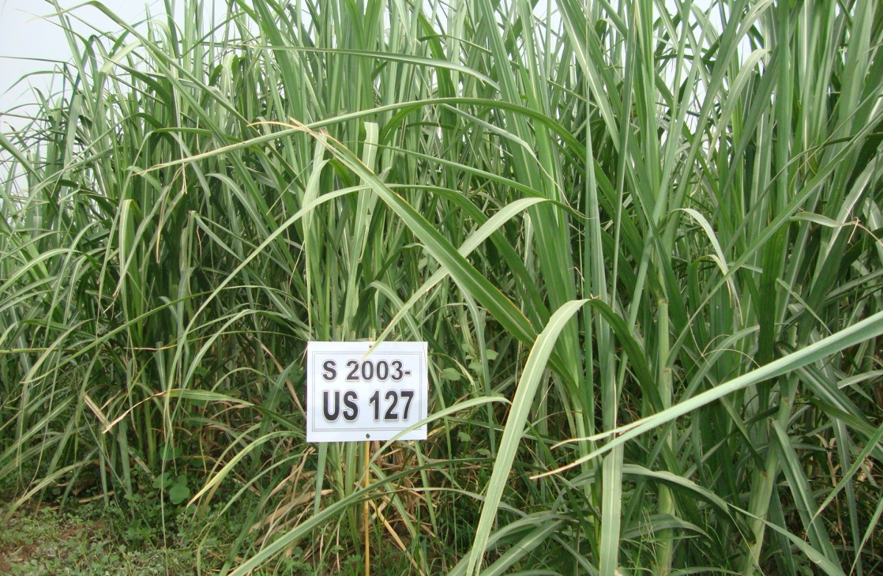
Potential Sugar Cane Varieties for Coming Years

Slide 23
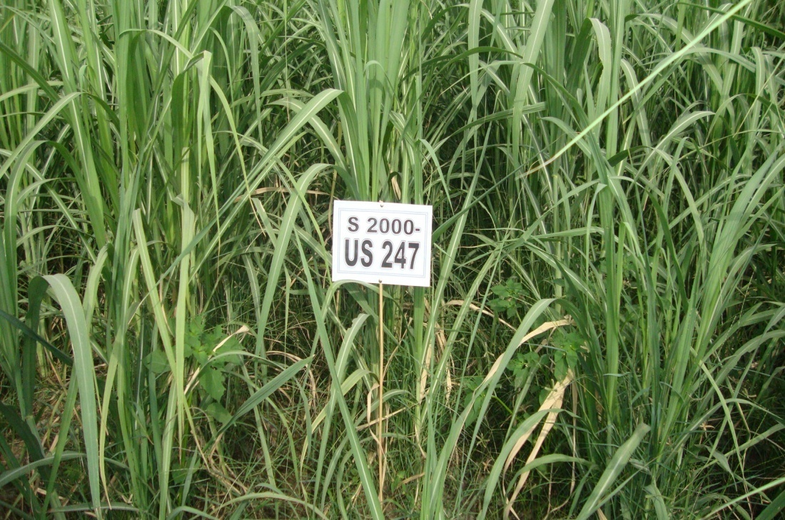
Potential Sugar Cane Varieties for Coming Years

Slide 24
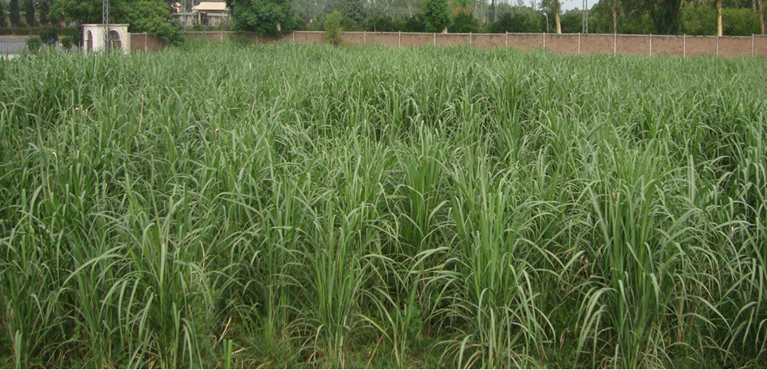
Potential Sugar Cane Varieties for Coming Years
S 2000 US-247

Slide 25
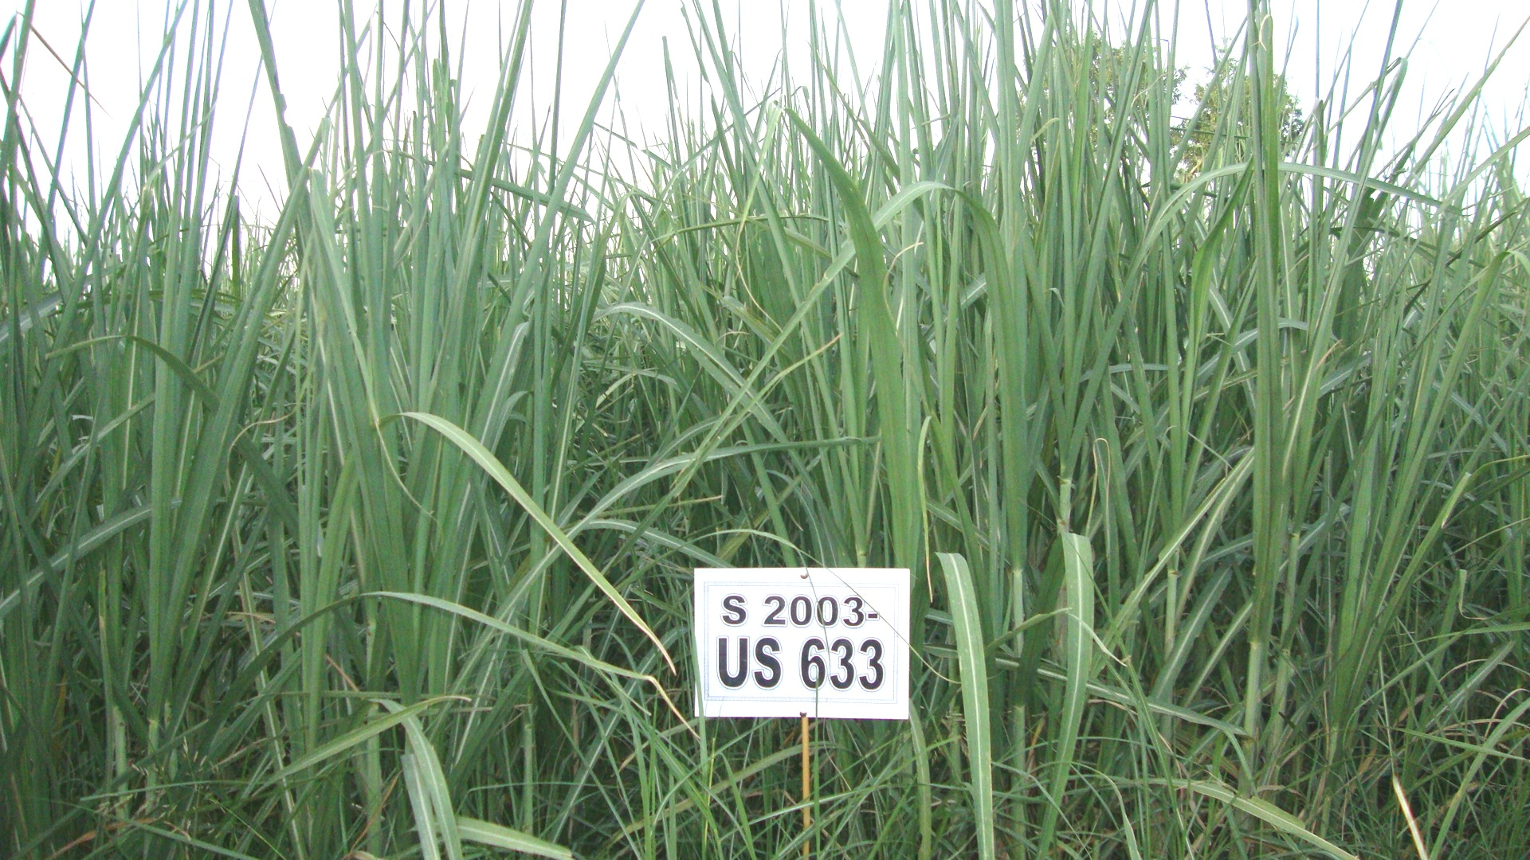
Potential Sugar Cane Varieties for Coming Years

Slide 26
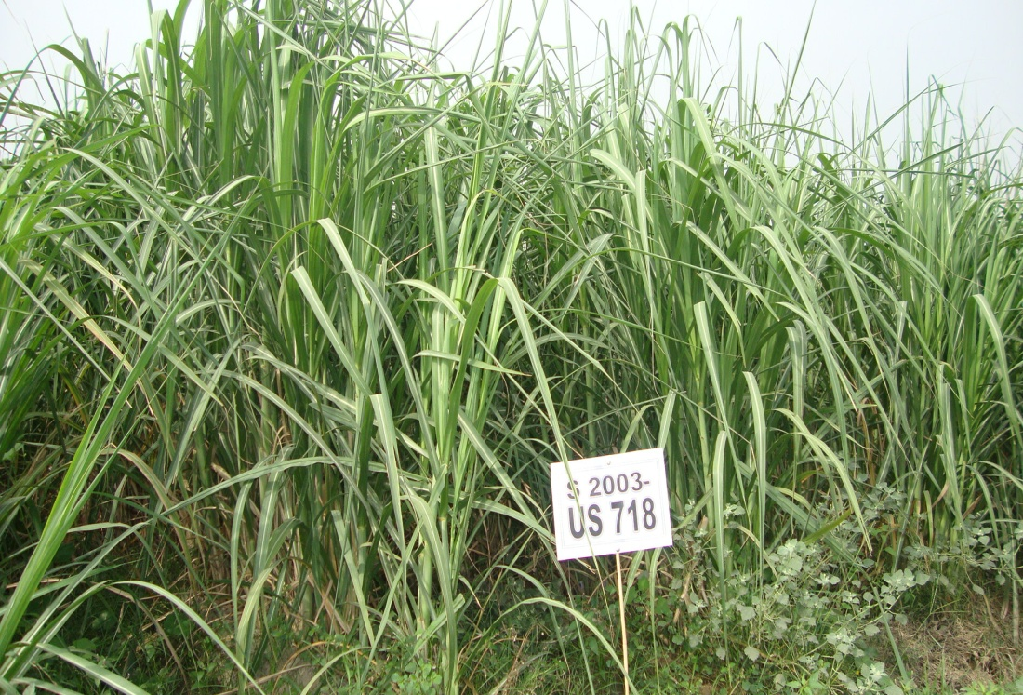
Potential Sugar Cane Varieties for Coming Years

Slide 27
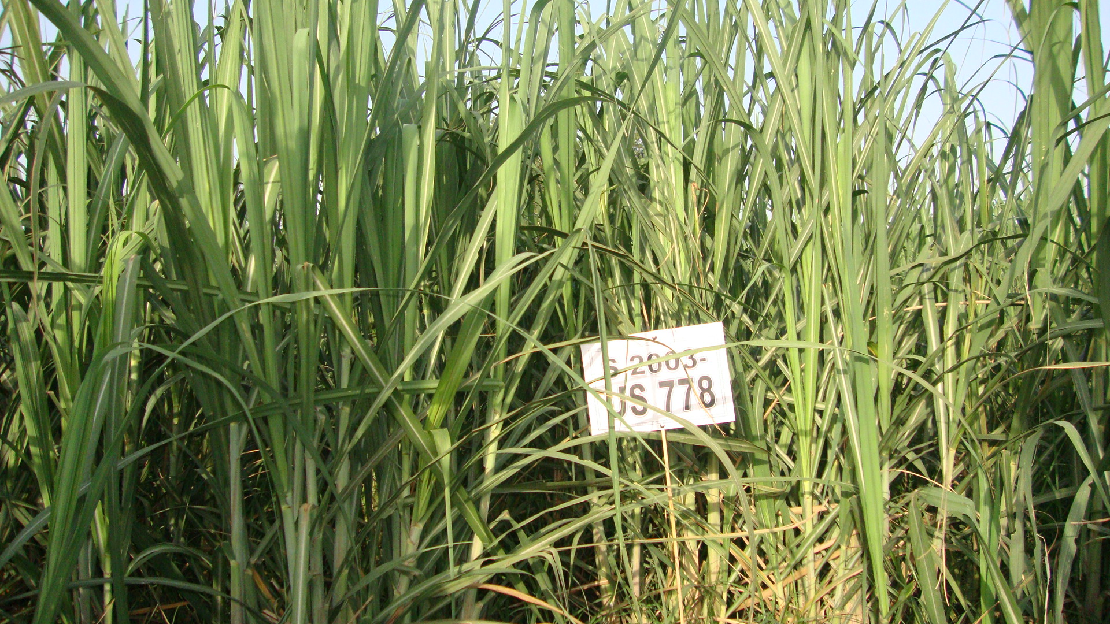
Potential Sugar Cane Varieties for Coming Years

Slide 28
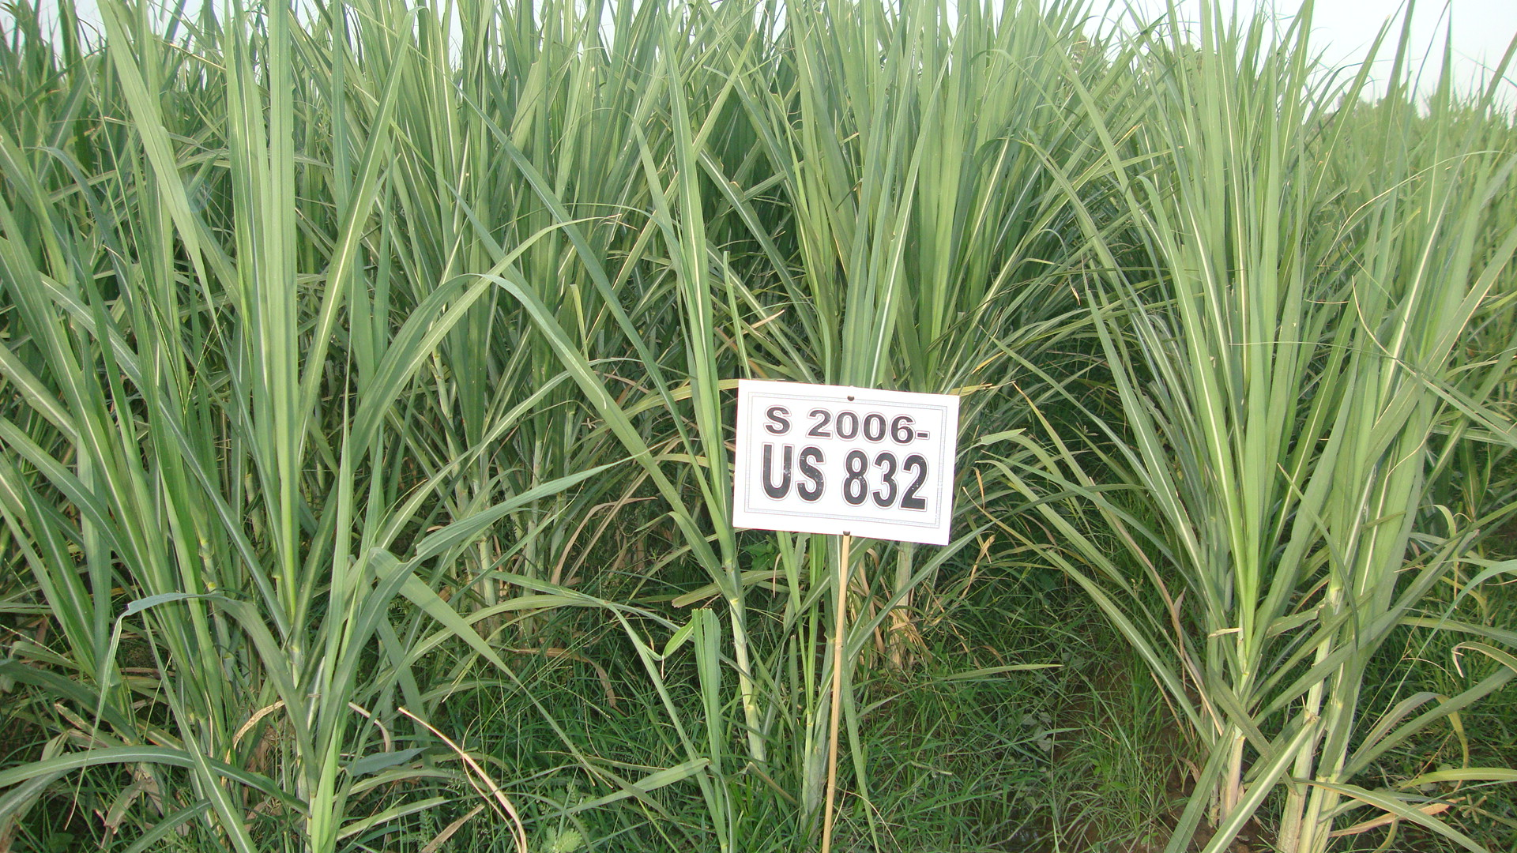
Potential Sugar Cane Varieties for Coming Years

Slide 29
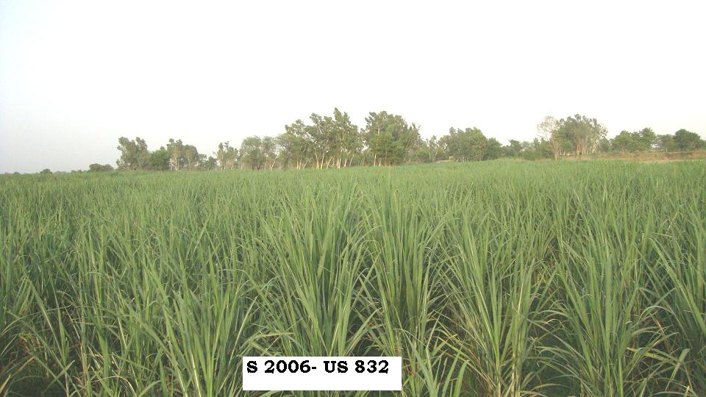
Potential Sugar Cane Varieties for Coming Years

Slide 30
Potential Sugar Cane Varieties for Coming Years
All the narrated varieties have tremendous potential to replace the existing varieties which have not been able to attract grower’s attention.
For the first time the grower is willing to replace the varieties being grown by him for years. We must grab this opportunity and ensure that he is provided the pure seed of the promising and potential varieties.
Establishment of small units of mills managed Farms at different convenient locations for seed multiplication and propagation are extremely pertinent so that by the time the above potential varieties are finally cleared and approved, we have sufficient area as seed available for issue to growers.
For achieving the desired objectives, it is advisable that every mill without any exception must reserve sufficient funds for providing inputs especially seed on loan to the progressive farmers.
This will help in spread /distribution of better quality seed in the desired area within shortest possible time.

Slide 31
Acknowledgment
I am extremely thankful to Dr. Muhammad Afzal, Sugar Cane Specialist from Ayub
Agricultural Research Institute (AARI), Faisalabad for providing necessary data and other valuable information in connection with the compilation of this paper.

Slide 32
Any Questions… ?

Slide 33
Thank You….

