Slide 1
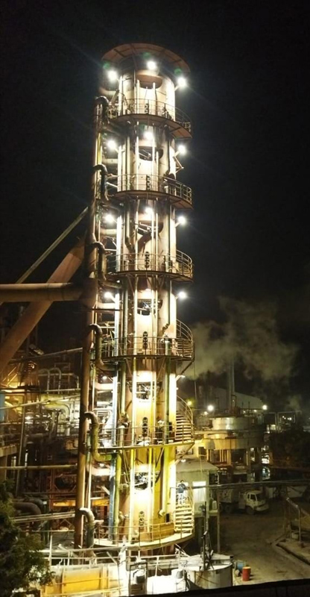

Spray
Continuous
Pan®
Presented By
Khalid Hanif – GM Process Faran Sugar Mills
M. Saad Masud – CEO SED

Slide 2
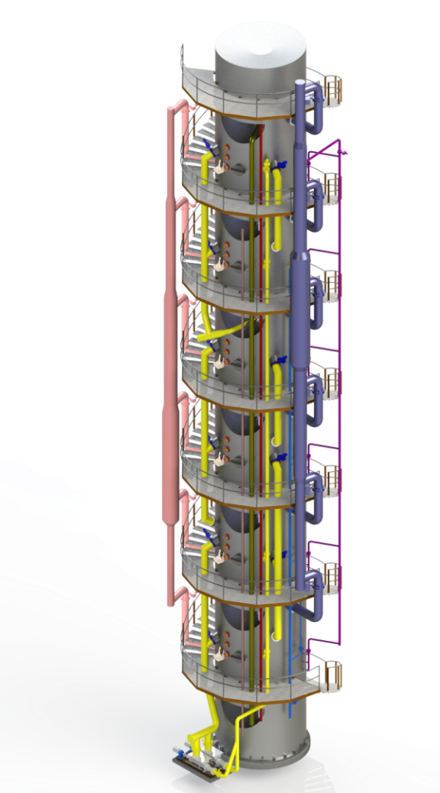
SCP®…The Game Changer
Steam Economy
Vertical Installation
Power Economy
Intelligent Operation
Improved Sugar Recovery
Honeycomb Calandria
Better Massecuite Quality
Automation Control System
Project Cost
Provision of Seed Pan
with Uniform Seeding
Payback / ROI

Slide 3
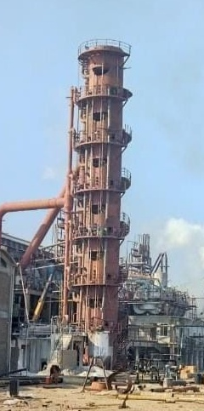
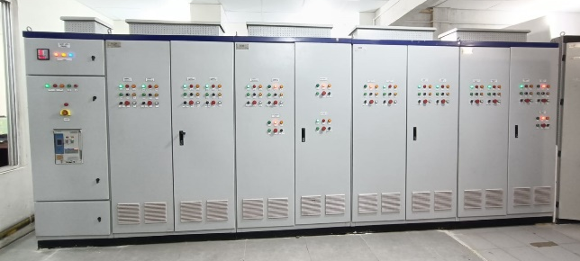
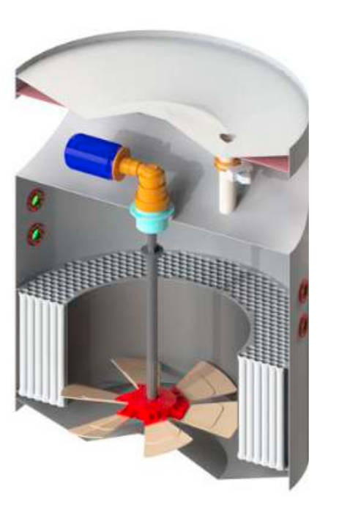
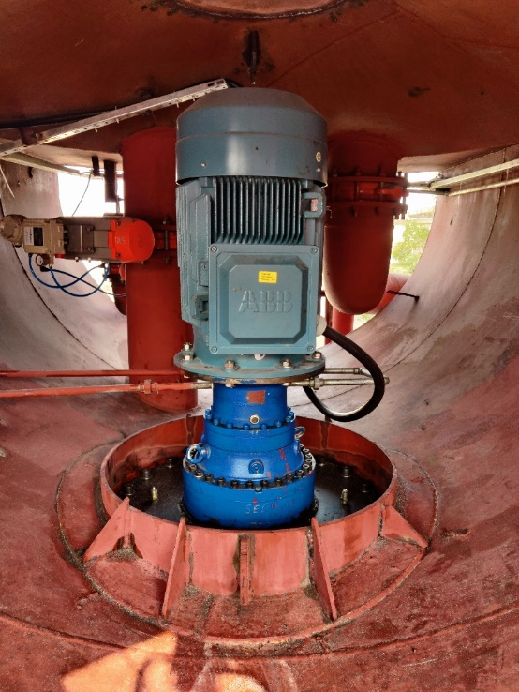
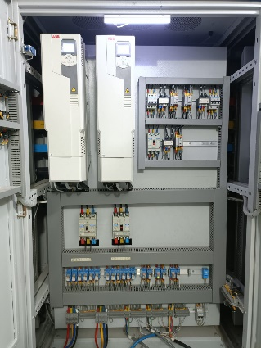
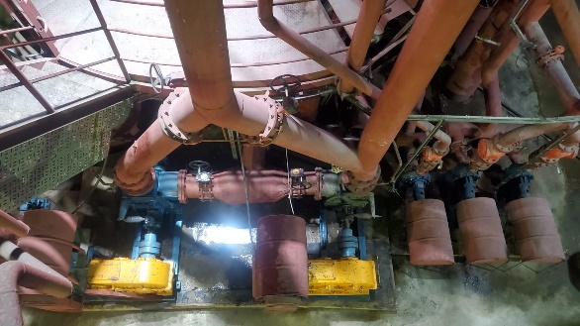
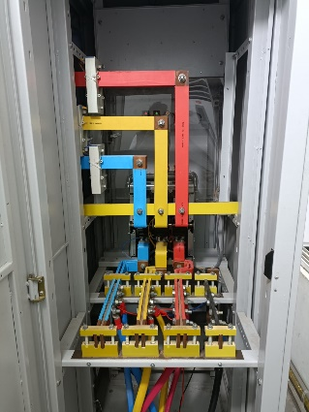
SCP Operations
Syrup / Water Tanks
Seed + Syrup
Vapor Line Header
Vacuum Header
Massecuite Discharge
Control Room
Pumping Station

Slide 4
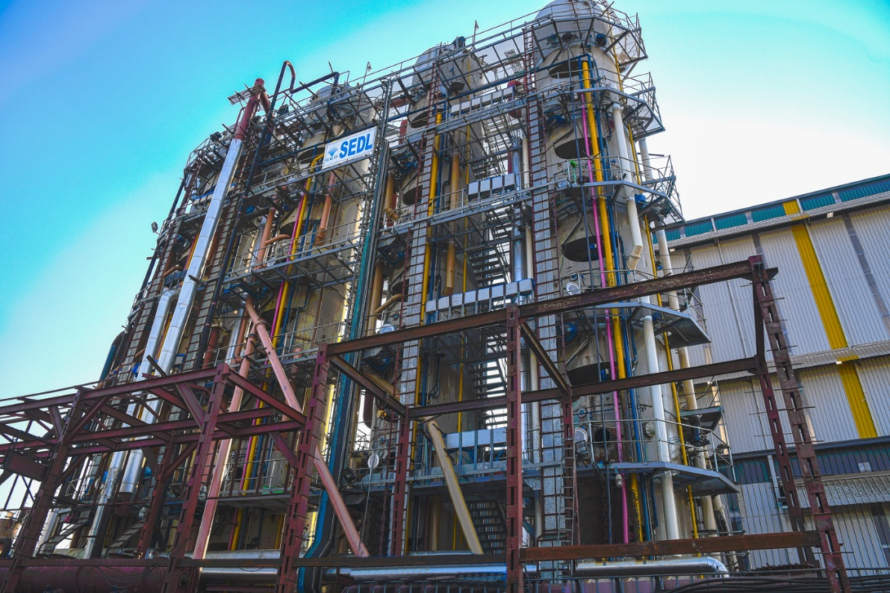
Vertical Installation
Lowest Footprint
Effective Space Utilization
Minimum Structural Requirement
Elevator for Operational Ease

Slide 5
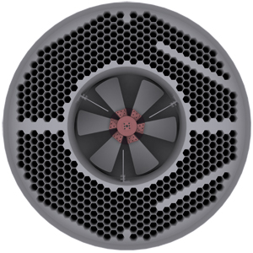
Honey Comb Calendria
Special design of calandria eliminates the dead space between the tubes (Ligament)
High steam economy
Highest crystal growth & higher sugar yield.
Greater Heating Surface
Flexibility of operation at 25-100% capacity

Slide 6
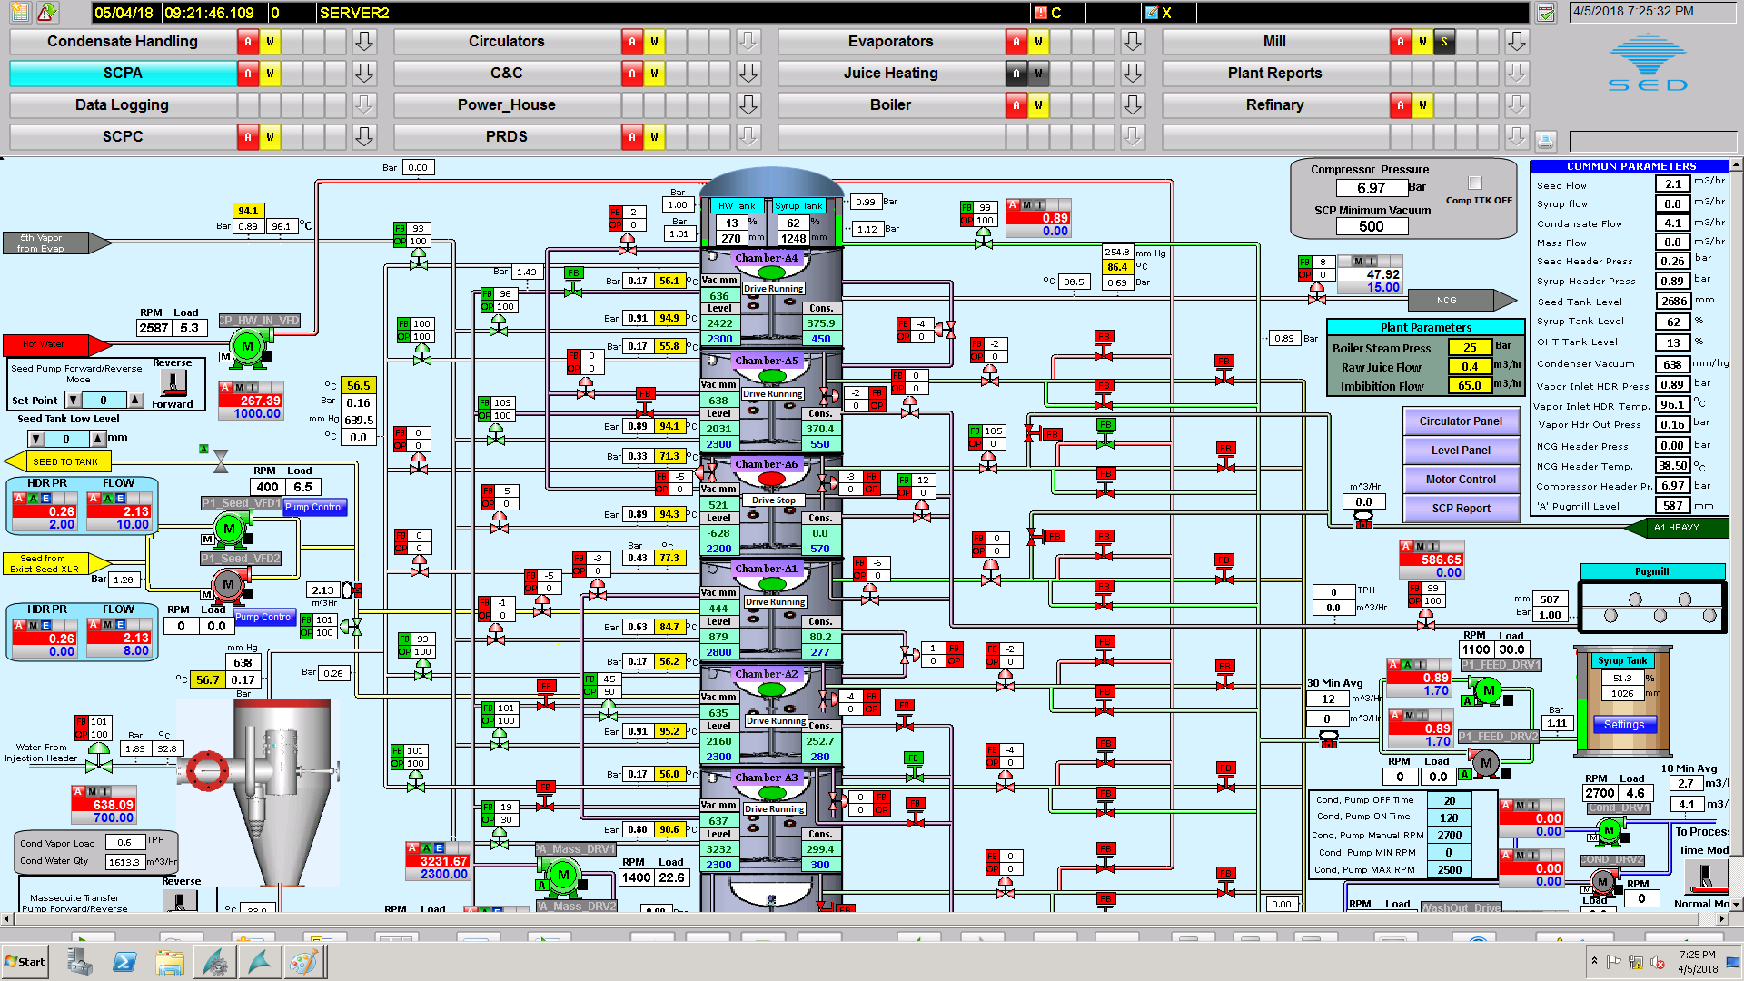
Automation

Slide 7
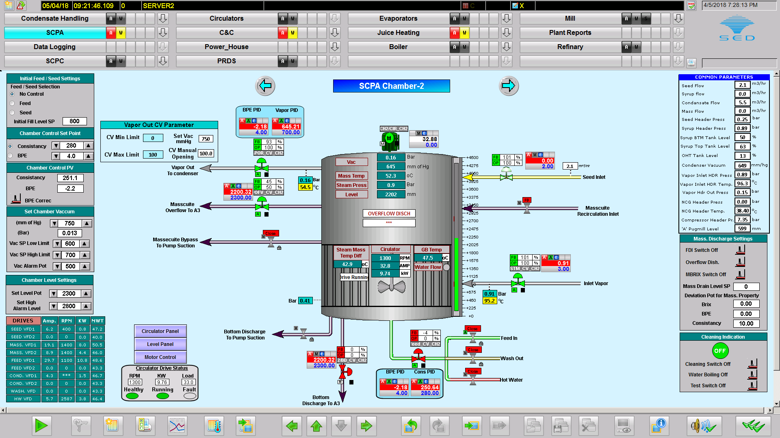
Automation

Slide 8
Automation
Process parameters control for individual chambers
Ease of operation
Auto cleaning / rinsing cycle of valves & sensors to minimize shutdowns
Seed / Feed ratio control for least crystal variation
Individual control of vapor in and out to achieve consistent boiling
Fully automated intelligent system resulting no skilled man power requirement
Provision for flow, temperature, pressure, level and consistency measurement for each chamber

Slide 9
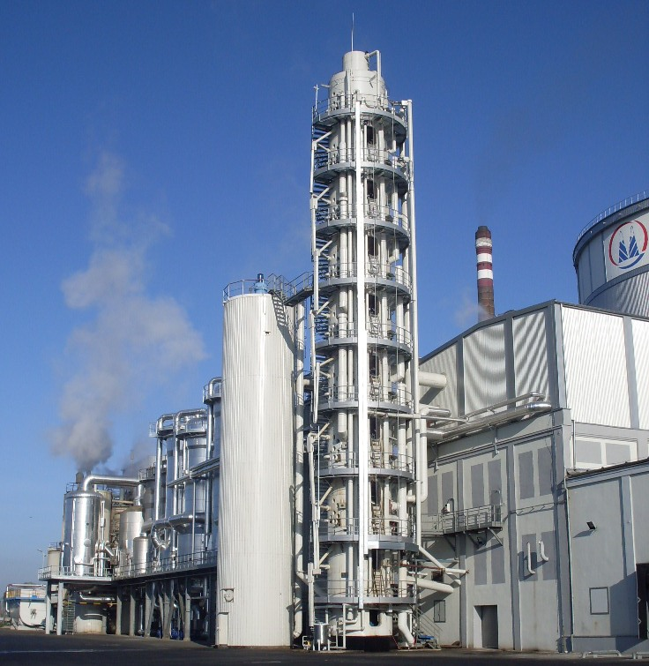
Seed Pan
SCP has its own Seed Pan for effective utilization of steam and its capacity
Uniform Seed feeding take care of false grain and conglomerates
Feed & seed ratio will provide better exhaustion

Slide 10
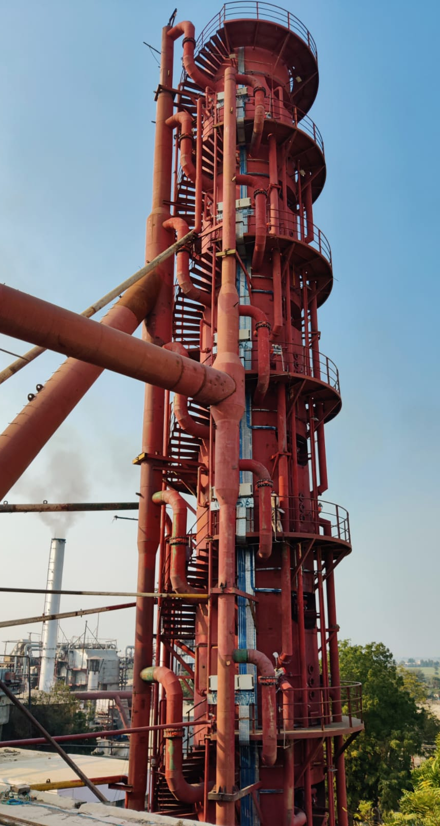
Steam Economy
High steam economy With Low Temperature Vapors of 90°C
No need of movement water
Low head boiling advantage
Better removal of noxious gasses to get full advantage of heating surface.

Slide 11
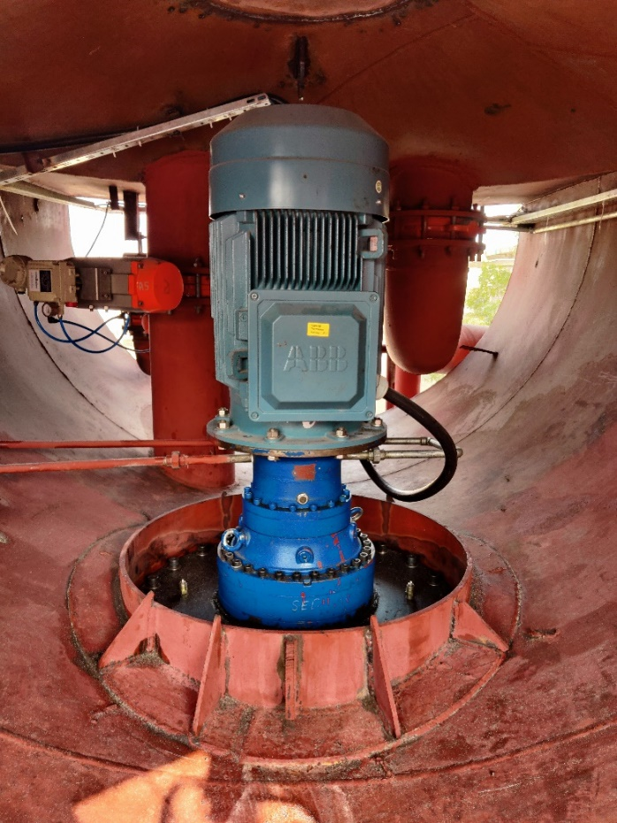
Power Economy
High Quality IE3 Motors
VFDs for efficient Power Utilization
Single Condenser.
No need of receiving crystallizers.
Transfer pump directly shift the massecuite into A-pug mill

Slide 12
Improved Sugar Recovery
Higher Molasses Exhaustion
Excellent purity drop b/w mass & molasses around 18-20 degrees
Crystal yield is around 55%
Molasses percent reduced considerably
Reduced recirculation of sugar during intermediate boiling resulting maximum capacity utilization.

Slide 13
Better Massecuite Quality
Colors of A-sugar extremely low Below 400 ICUMSA
Reduced consumption of refinery chemicals
Regular size of sugar crystals helps in purging of Massecuite.
Massecuite free from conglomerates & false grain.
Extremely low Quantity of wash water during purging, reduces the quantity of A-heavy and less evaporation load for B boiling.

Slide 14
Project Cost
Capacity : 100T/Chamber
Heating Surface : 487x6= 2922m²
No. Of Chambers : 06
S/V Ratio : ≤ 7.5
Number of Tubes : 1295/Chamber
Tube Dia : 80 mm
Tube Length : 1.5 Meter
Tube MOC : SS-304
Duty : ‘A’ Massecuite
Continued…

Slide 15
Project Cost
SCP 06 Chambers
Honey Comb Calendria with SS-304 Tubes
Mechanical Circulators with Planetary Gears for each Chamber
Staircase and Support Structure
Civil Foundation
Pumps, Motors, VFDs
Internal Pipes and headers for Vapor, Vacuum, Syrup etc.
Automation with Cables and Panels
Valves
Condenser

Slide 16
Pay Back / ROI
Bagasse saving/day = 464,520 PKR
Power saving/day = 152,425 PKR
Impact of molasses = 526,400 PKR
Total saving per day = 1,143,345 PKR
Total Cost of Project = 25 Cr PKR
Payback period = 218 Days
About 2.18 Seasons.

Slide 17

SCP is Proudly
Made in Pakistan
by
Sustainable Environment Developers
Head Office: B-144, Block 11, Gulistan-e-Jauhar, Karachi.  +92-21-34184313  contact@sedl.pk
Factory: C-66, Phase I, S.I.T.E –II, Superhighway, Karachi.  : +92-300-0342650  www.sedl.pk

