Slide 1

ROLE OF ELECTRICAL & AUTOAMATION ADVANCE TECHNOLOGY TO IMPROVE PROFITABILITY OF SUGAR INDUSTRY
﷽
M. Adnan, Manager (E & I)
m.adnan@sgroup.pk
M. Saeed (DGM E & I)
m.saeed@sgroup.pk
Atif Sattar (P.D. Sb)
atif.sattar@sgroup.pk

Slide 2
ABSTRACT
Concept of this presentation based on understanding the DCS/Automation systems, integrated with new Technologies a Comprehensive & Intellectual Management tool to control plant & implement polices. Some Plant Operational limitation supervised & planed to solve with collaboration of this tool. We try to attract attention of Sugar Mills Engineers on Automation Project failure's causes in Sugar industry. How a complete future plant modifications facilitated by DCS & how Corrective & preventive maintenance plans be drawn by this tool be explained in this topic. Operation Tracking of each & every event now possible to store for evaluation of operator performance & plants machines schemes be drawn by DCS system.

Slide 3
HOW PROFITABILITY BE IMPROVED OF AN INDUSTRY?
LOW COST RAW MATERIAL/INPUTS.
HIGHLY EFFICIENT MACHINERY.
REDUCE ENERGY LOSSES.
INCREASE PRODUCTIVITY.
LOW MAINTENANCE COST.

Slide 4
HIGHLY EFFICIENT MACHINERY.
REPLACEMENT OF STEAM TURBINES WITH ELECTRIC MOTORS INTEGRATED WITH VARIABLE SPEED DRIVES.
  Over all machine efficiency of Steam turbine 25% to 35 % less than electric motors. Turbines are effective with a reason of high starting torque which can now be compensated by using VFDs even on high torque application. Machine efficiency defined as total energy`s part converted into work done.
TOTAL ENERGY
MACHINE
WORK DONE
LOSSES

Slide 5
We have shredder with two couple motors installed 2500 Kw power each operated with VFDs. Following observation being shared getting online data recording by DCS system.
Induction motors with VFD integration are high response impulse torque counter machines that is 200% to 300%, more speed effective as compare to Steam Turbines.
High Angular inertia resulting in smooth preparation of cane that can be observed in turbine application, rpm varies 100 to 200 in regular operation that is 10 to 20 rpm in case of Electrical system.
Minimum variation in system leads to stability also resulting in energy saving which is an efficiency enhancement.

Slide 6
Soft Link
MASTERVFD
3400
KVA
SLAVE
VFD
3400
KVA
Motor
2500Kw/690V
SHREDDER
Motor
2500Kw/690V
11KV/690V
11KV/690V

Slide 7
Mills House Motors & Steam Turbine comparison
Plant Capacity | 16000 TCD/666.66 TPH
% Cane | 38
Process Steam | 253 TPH
Power requirement | 16 MW
Bagasse to Steam Factor | 2.15
 | Electric Drive | Steam Drive | Electric Drive
Boiler Parameters | 110 bar/550 C | 25 bar/350 C | 25 bar/350 C
Steam Against Power (TPH) | 104 | 229 | 160
Make Up Steam Required | 149 | 24 | 93
Steam against PRDS 1.2 bar/135 C (TPH) | 41.6 | 4.8 | 18.6
Bagasse Saved Excluding Losses (TPH) | 19.35 | 2.23 | 8.65
Bagasse Saved Excluding Losses (Day) | 464.37 | 53.58 | 207.63
Bagasse Saved Excluding Losses (Season) Ton | 46437.21 | 5358.14 | 20762.79
Cost Saved /h (Rs. 5000/ton) | 96,744.19 | 11,162.79 | 43,255.81
Cost Saved /d (Rs. 5000/ton) | 2,321,860 | 267,907 | 1,038,140
100 days crushing season (MPKR) | 232.19 | 26.79 | 103.81
Export MWh Generation Hourly | 24.8 | 2.4 | 9.3
Export MWh Generation Day | 596 | 57.6 | 223.2
Export 100 days Mwh Generation | 59600 | 5760 | 22320
Cost of Export power for 100 Days (MPKR) Rs. 13/kwh | 774.8 | 74.88 | 290.16

Slide 8
VFDs AN ADDITION OF REDUCTION IN MAINTENANCE COST & INCREMENT MACHINE`S LIFE.
VFDs not only a Machine for energy conservation with good rpm control but a condition monitoring system as well a shock absorber which is important to protect Mechanical/Electrical machines from abnormal condition. Condition monitoring by VFDs effectively work with historical programming of DCS. Trend comparisons can plan out preventive maintenance in season as well forecast mechanical/electrical machines upcoming deformation.
User flexibility a main part of VFD provide wide programming range which can be logically designed on behave of plants responses. Plant responses are variable depends on plant infrastructure as well operational team.
Only VFD`s operated motors are capable to deliver capacity torque even on static point.

Slide 9
Considering Shredder as case study table is showing Torque values in which Torque fluctuate periodically.
Maximum Torque | 11000 KNm
Nominal Torque | 8000 KNm
Mean Torque value | 4000 KNm
Curves are showing how VFD counter abnormal situation resulting in avoid wear &tear. Ultimately reduce the maintenance cost & increase replacement time . 30% to 35 % reduction in maintenance cost observed by individual unit.
 |  |  |  |  |  |  |  |  |  | Load
 |  |  |  |  |  |  |  |  |  |  | rpm
 |  |  |  |  |  |  |  |  |  |  |  | Load
 |  |  |  |  |  |  |  |  |  |  | rpm
 |  |  |  |  |  |  |  | VFD response
 |  |  |  |  |  |  |  |  | Physical Interuption

Slide 10
Crushing Rate Vs Kwh hourly consumption

Slide 11
DCS REVOLUTIONERY ADDITION IN SUGAR INDUSTRY
As profitability be improved by, HIGHLY EFFICIENT MACHINERY,REDUCE ENERGY LOSSES,INCREASE PRODUCTIVITY/CRUSHING RATE.LOW MAINTENANCE COST. All these co-related with effectively implementation of DCS.
DCS (Distributed Control System) offers following Major System Controls.
Fixed the parameters.
VFDs performance increased 10 to 15% by efficiency.
Condition Monitoring/ a best predictive tool for Sugar Mill Operation.
A management Tool for future modification.
Record maintenance & Data Acquisition.
Event Log & Interruption Indicator.

Slide 12
FIXED PARAMETRIC CONTROL A COMPULSORY REQUIREMENT OF SUGAR INDUSTRY.
Sugar Industry due to seasonal operation has an operating gape persist 4 to 6 days in the start of every season causses unpredictable losses in terms of energy, crushing/productivity & material handling. We can strongly avoid from this situation in every season by fixing numbers in DCS & get back on normal operating conditions without loosing precious time resulting in getting targeted crushing figure & overcome losses.
Unpredictable losses are those happen beyond analyzing time or without periodic behavior. Online measurement & set point continuous tracking of parameters minimize these unpredictable losses significantly.
It is observed that increase in 13% to 15 % Crushing capacity by reducing small scale operational gaps.

Slide 13
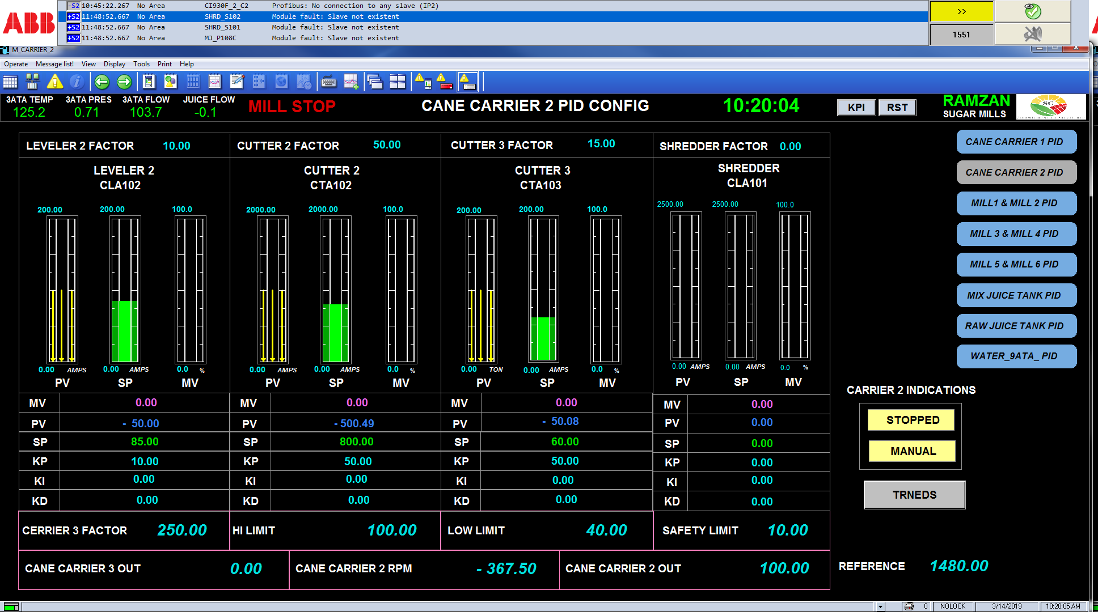
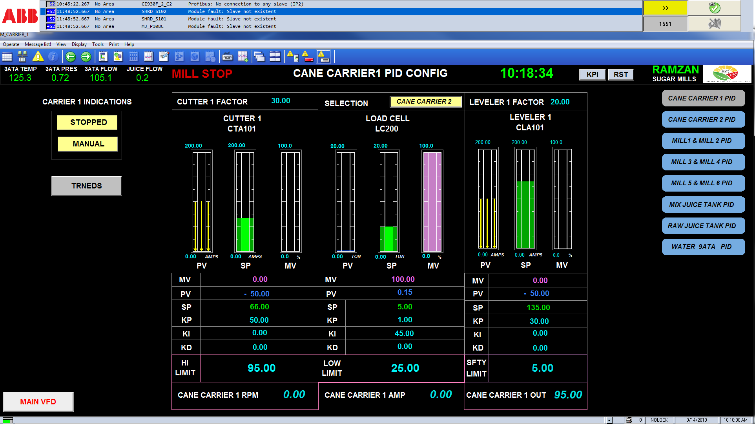

Slide 14
VFDS EFFICIENCY INCREMENT WITH DCS COORDINATION.
As discussed in previous up page due to continuous tracking to achieve set point DCS control VFD`s operation in such a way responds according to plant reaction by changing its prime mover power demand synchronized with system requirement continuously without delay. Almost 10 to 20 % more energy conserve.
MACERATION SECTION
 |  | Kwh hourly
Pump No. | Motors Ratings | Y/delta | VFDs with fixed Max. rpm | VFDs DCS opr. | US/VFD | US/DCS
1 | 55 Kw | 47 | 39 | 39 | 8 | 8
2 | 55 Kw | 45 | 38 | 39 | 7 | 7
3 | 37 Kw | 26 | 21 | 16 | 5 | 10
4 | 37 Kw | 25 | 19 | 15 | 6 | 10
5 | 37 Kw | 24 | 19 | 15 | 5 | 9
6 | 37 Kw | 24 | 18 | 13 | 6 | 11
 |  |  |  |  | 37 | 54
Energy Saving /13 PKR Hourly |  |  |  |  | 481 | 702
Energy Saving /13 PKR 24 hours |  |  |  |  | 11,544 | 16,848
Energy Saving /13 PKR 24 hours X 100 days |  |  |  |  | 1,154,400 | 1,684,800
Mwh Saved for Season Approx. |  |  |  |  | 88.8 | 129.6
An exercise has been performed during season & found results that showing 80 to 130 MWh saving per season (100days) on centrifugal pumps driven by DCS with VFDs integration at Maceration station.

Slide 15
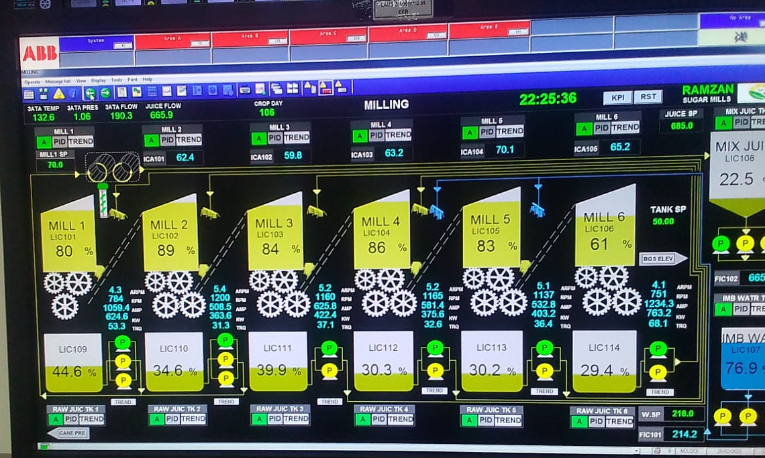

Slide 16
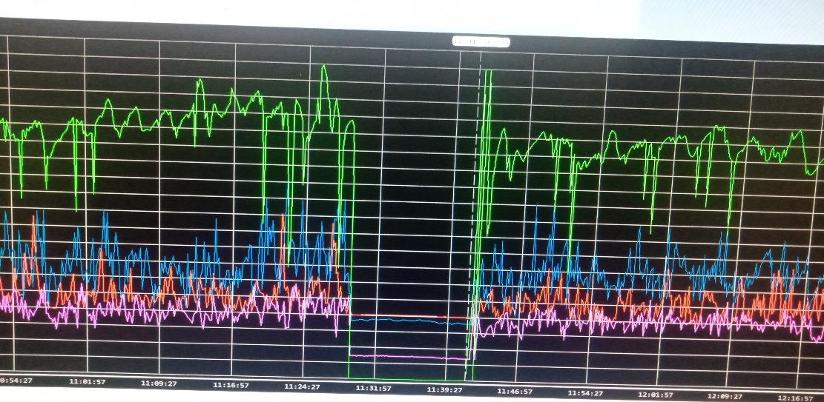
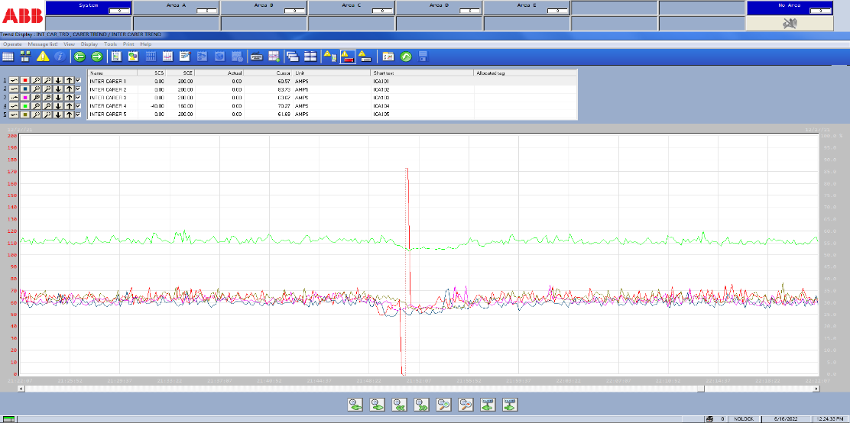
DCS AS A CONDITION MONITORING & BEST PREDICTIVE TOOL FOR SUGAR PLANT.
New technologies approaches Machine condition evaluation by analyzing currents & voltages graphs by highly expensive instruments. These machines provides all information related Electromechanical condition of motors as well connecting equipment gear, pumps etc. With DCS Trend making capability we can diagnose machine abnormal behavior in advance & make precautionary measures to avoid any damage. Physical abnormality always diagnose after 30 to 40 % damage, however its causes predicted by electrical prints at same time of situation happen to deform the machine.

Slide 17
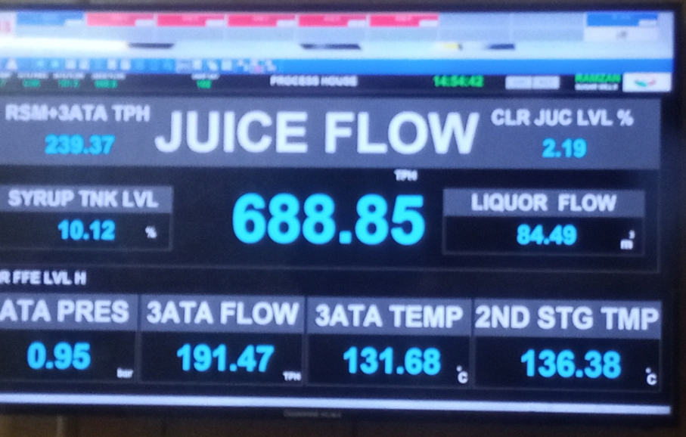
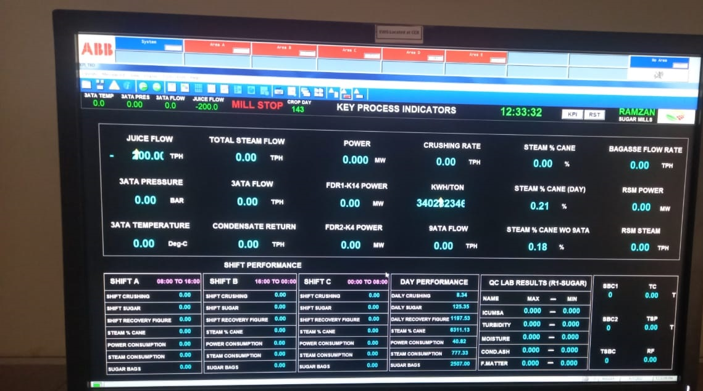
DCS A MANAGEMENT TOOL FOR PLANT MODIFICATIONS .
An analytical approach always depends upon available data for related parameters. DCS trend locking for long period of time provide helps to evaluate the exact system requires needs to be modified a particular machine.
A common error found in manual observation that cannot be analyze a set of parameters due that pin point limitation avoided. In this condition situation meets to replace several equipment to get require parameters. However DCS provide range of depending parameters on single page, that make data analyzing to evaluate performance deficiency significantly. More accurate decision saves money & time, enhance the profitability & furnish the plant condition.

Slide 18
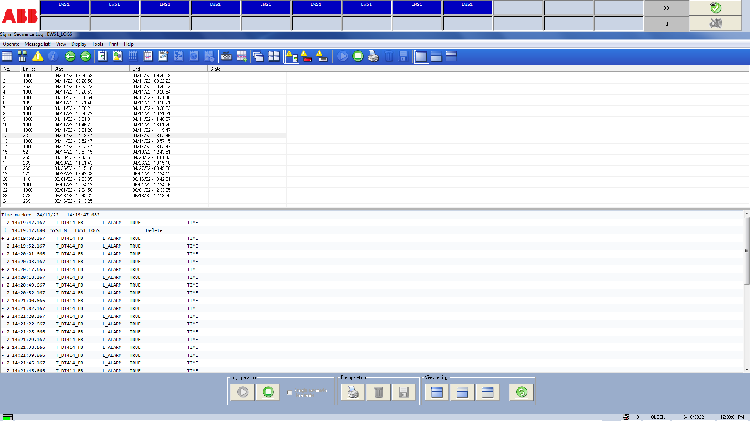
DCS EVENT LOG & INTERRUPTION INDICATOR.
An event of Mills stop due to any fault can be easily trace out with DCS event logging. Event logger save every change which is entered by operator & parameter deviation limit crosses the sets values. We can easily found the right reason which happens to cause Mills Stop.

Slide 19
OPERATOR TRICKS CONTROL & 100% POLICY PARAMETRIC INSURANCE ONLY POSSIBLE WITH STRONG FIELD INSTRUMENTATION AND DCS.
Operator Cheats are found commonly in manual operation, however DCS System only control these cheats by logging events & drawing trends. Cheats are apply to avoid deep attention which are required to maintain parameters. Some cheats be found due to P&IDs & Insufficient Instrument installation of plant, Management Pressure to control some important parameters leads to discover cheats methods.
O2
O2

Slide 20
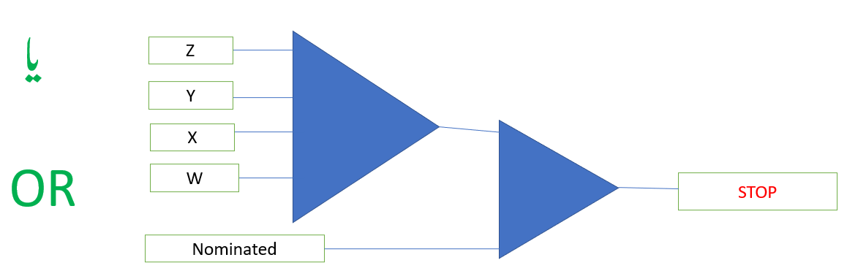
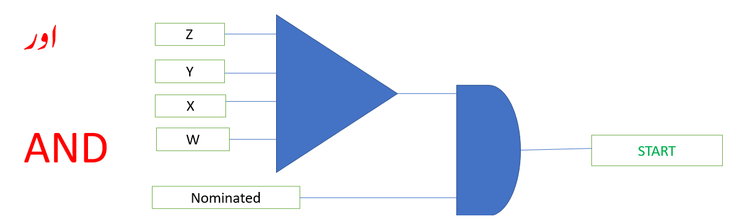
SAFETY CONTROLS
Mostly accident are reported in sugar plants during starting the machines due to protocols are not defined if protocols are defined controls are not too much effective. By the logical implementation of Automation we can control safe startup & shutdown of machines, Logical interlocks fix the authority of startup saves Men/Machines life. In the following diagrams we can see that to stop machine is a flexible command be adopted with any authority, however start command is fixed with nominated person(This person responsible to declare Men machine safety environment to start the machine).

Slide 21
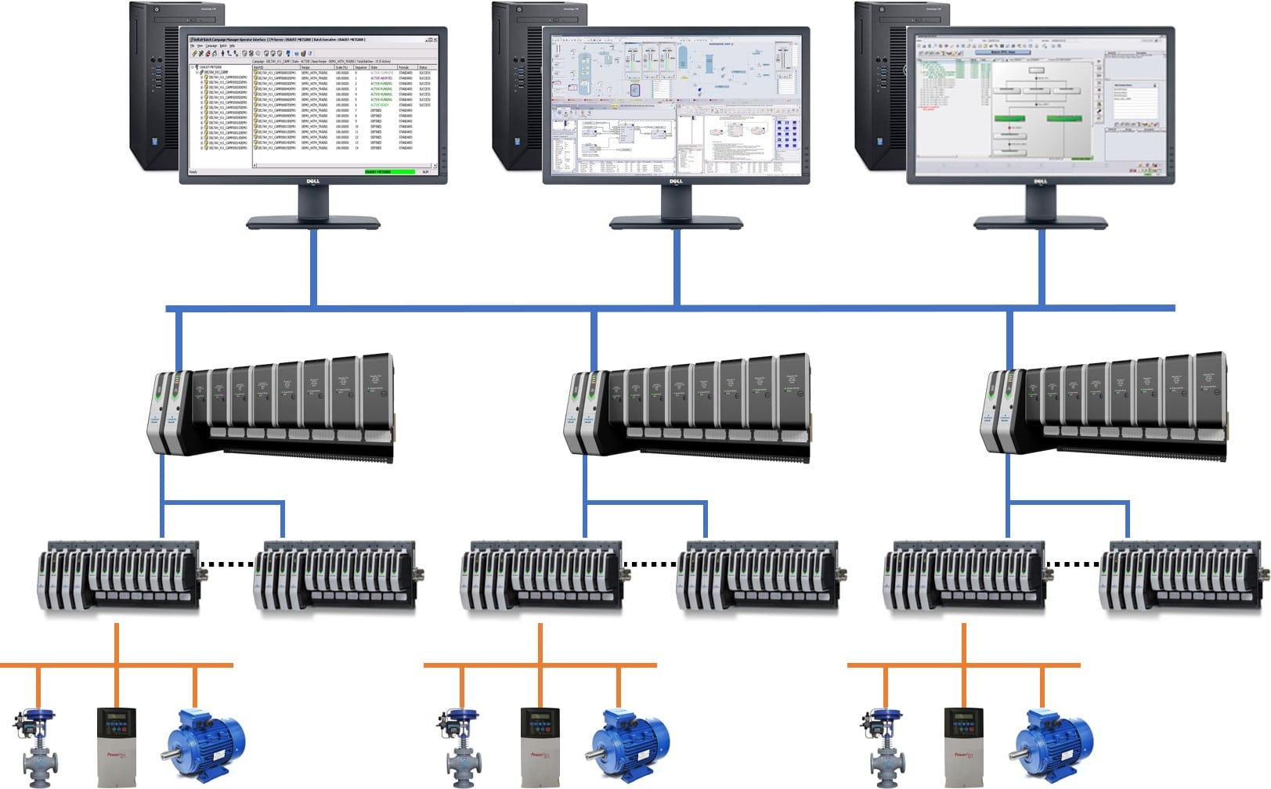
AUTOMATION SYSTEMS (DCS Vs PLC)
In sugar industry modifications works are always in pipe lines. Experiences decide the different operating methodology, so it is recommended that automation system should be flexible enough to introduce new logics according to best possible solution by domestic resources. Easy extensions should be available & implementation even in season without any interruption of Mills operation demands Installation of DCS. PLC now consider as small scale automation system & required special skills technical resources with limited options.

Slide 22
LIMITATION OF AUTOMATION PROJECT OBSERVED IN SUGAR INDUSTRY.
Plant Piping & Instrumentation Diagrams are not available or not designed by Technical Experts.
Selection of measuring Instrument according to fluid properties to approach accuracy not considered.
Absence of calibration experts & standard handling procedures.
Reluctant behavior of operators(Education gap, lack of trainings).
Logic improvements always needs feedback of operational staff about the problems they are facing actually. Communication gap a considerable factor that is mostly effect a project.
Modification of machines without considering new demands raised by installed automation system accordingly.
Logic & Tunings flexibility are not present in system software designed causing limitations to operate on automatic mode at different crushing rates.

Slide 23
THANKS

