Slide 1



Slide 2
Performance of Promising Sugarcane Elite
Line YTFG-236 in Punjab, Pakistan
By:
Dr. Syed Zia Ul Hussnain, Zulfqar Waseem Malik, Mushtaq Ahmad & M. Umair Farooq
Fatima Sugar Research & Development Centre (FSRDC),
Fatima Sugar Mills Limited, Kot Addu

Slide 3
Welcome to
Fatima Sugarcane Research and Development Centre (FSRDC).
Research at FSRDC is clustered within four multidisciplinary programmes, namely Variety Improvement, Crop Protection, Crop Performance & Optimization.
Research being conducted at the research centre is building a bridge between the organization and farmers through advanced agriculture technology.
FSRDC also offers a range of services including fertilizers advisory, disease diagnoses and educational courses to the farmers.

Slide 4
Goal
To develop sugarcane varietal and production technologies for sustainability of the industry in Pakistan.

Slide 5
Clonal Selection Criteria
Selection Stage | Plot size/Selection Criteria stage | Selection Criteria
Stage-1 (Nursery) | Single stool 10-15 % | Growth, Stooling, Stalk size, Freedom from naturally occurring diseases and periodic brix %.
Stage-2 (Progeny) | 5 m single row Single plot 10-15 % | Germination, Tillering, Growth, Stooling, Stalk number, Side shooting, Erectness, Pithiness, Piping, Lodging, Free from naturally occurring diseases, Artificial inoculation of Red rot, Brix %.
Stage-3 (Advance) | 6.5 m x 6 rows Single plot 25 % | Same as in stage-2 Yield estimates, Herbicide susceptibility, Natural infestation of borers/other insects and Brix %.
Stage-4 (Q.Final) | 6.5 m x 4 rows 3-4 replications 25 % | Same as in stage-3 Agronomic trials with more emphasis on ratoonability, Pathological trials,tests on Post harvest losses and Periodic quality analysis (brix, pol, purity and recovery % cane.
Stage-5 (Semi-Final) | 9 m x 6 rows 3-4 replications 25 % | Same as in stage-4 Coordinated trials, numbers of sites and years.
Stage-6 (Final) | Block planting 1 acre 50% | Plantation acceptance (Plant + Ratoon Crop) Coordinated trials on growers fields, numbers of sites and years.
Stage-7 | 2-5 acres (25-sites) 50 % | Commercial planting Same as in Stage-6 Out field trials.

Slide 6
Sugarcane variety development at FSRDC
Fuzz / Clones Detail
Organization | No. of crosses / Clones | Year
USDA-ARS CP, USA | 70 | 2015
PARC & SSRI, JHANG Lines from YT & S2012CP-Series | Total- 150-Clones | 2015
USDA-ARS CP, USA | 35 | 2016
USDA-ARS CP, USA | 40 | 2017
BARBADOS (SRDB) | 38 | 2018
SRI-LANKA (SRDB) | 68 | 2018
FRANCE (SRDB) | 09-Clones | 2018
INDIA (SRDB) | 01-Clones | 2018
AUSTRALIA (SRDB) | 01-Clones | 2018
USDA-ARS CP, USA | 14-Clones | 2018
SRI-LANKA (SRDB) | 50 | 2019

Slide 7
Present Status of Germplasm
Stage | Seedling Year/Source of fuzz | Number of seedlings/Lines
Stage-7 | Promising Lines / NUVYT
 | i USA & FG- lines (S2012CPFG-110, YTFG-236 ) | 03
 | ii S2015 CPFG , Canal Point, USA | 07
 | iii USA, France, India & Australia (Introduction) | 25
 | iv NUVYT (2020-2022 & 2021-2023) | 19
 | Sub. Total | 54
Stage-6 | Final lines
 | S2016 CPFG, Canal Point, USA | 05
 | Sub. Total | 05
Stage-5 | Semi Final lines
 | S2017 CPFG, Canal Point, USA | 09
 | Sub. Total | 09
Stage-4 | Quarter Final lines
 | S2018 CPFG, Canal Point, USA | 27
 | Sub. Total | 27
Stage-3 | Advance lines
 | S2019 CPFG, Canal Point USA | 104
 | Sub. total | 104
Stage-2 | Progeny lines
 | S2020 CPFG, & S2020 SLFG Series | 261
 | Sub. total | 261
Stage-1 | Seedling / Source
 | S2021 CPFG, & S2021 SLFG Series | 5,270
 | Grand total | 5,730

Slide 8
Abstract.
Sugarcane germplasm were donated by PARC, Islamabad to Fatima Sugar Research and Development Centre (FSRDC), Fatima Sugar Mills Limited in 2015 including YT-236 (parental clones of YN 73-204 X CP72-1210).
The screening process was conducted at FSRDC during 2015-2022 to evaluate area specific sugarcane variety for Punjab.
Zonal field trials were also carried out at different locations on grower’s fields.
After getting the NOC from the concerned authorities, clones renamed as YTFG-236.
The promising line YTFG-236 having the cane yield potential (150.9 tons/ha) and sugar recovery % (13.03) as the standard check varieties.
The results also revealed very early maturing trend, higher yield potential with excellent ratoonability, non-lodging behavior, resistant to insect-pest and major diseases.
The clone is promising, excellent and growers friendly have the potential of becoming future varieties to meet the needs of the fast-changing sugar industry of Pakistan.

Slide 9
The Filters from which the
Clone YTFG-236 Permit
Sr.No. | Descriptions | Status
1. | NUVYTs Trial (2019-2021). | Completed
2. | DNA Fingerprinting from Agri. Biotechnology Research Institute, AARI Faisalabad. | Completed
3. | DUS trial (02-year) from Federal Seed Certification & Registration department, Islamabad. | Completed
4. | Zonal Field trials. | Completed
5. | Planted on around 3,500 acres in FSML area of Muzaffargarh and also in different zone in Punjab. | Highly Acceptable

Slide 10

Results at FSRDC-FSML
(During 2016-2022)

Slide 11
Average Yield ( tons / ha) of Promising line YTFG-236 at FSRDC-FSML During 2016-22
variety | 2016-17 | 2017-18 | 2018-19 | 2019-20 | 2020-21 | 2021-22 | 06-Year Avg.
 | Yield | Yield | Yield | Yield | Yield | Yield | Yield
YTFG-236 | 114.20 | 110.90 | 122.10 | 150.90 | 139.80 | 142.80 | 130.12
CPF-253 | - | - | - | 112.10 | 126.10 | 136.40 | 124.87
CPF-237 | - | - | - | 121.10 | 110.20 | 112.50 | 114.60
SPF-234 | 101.20 | 96.60 | 110.10 | 118.40 | 126.10 | 117.90 | 111.72
CPF-246 | 98.10 | 108.00 | 112.50 | 108.10 | 109.80 | 120.20 | 109.45
CPF-247 | 111.70 | 93.30 | 106.50 | 122.60 | 99.80 | 116.50 | 108.40
CPF-250 | 101.20 | 97.70 | 116.40 | 98.50 | 110.00 | 113.60 | 106.23
CP77-400 | 102.40 | 95.50 | 111.20 | 108.00 | 94.30 | 104.30 | 102.62
CPF-251 | 94.30 | 96.20 | 83.30 | 89.60 | 90.70 | 101.20 | 92.55
HSF-240 | 79.20 | 92.10 | 84.40 | 101.20 | 90.50 | 91.20 | 89.77

Slide 12
Average Recovery % ( Nov.-Mar.) of Promising lineYTFG-236 at FSRDC-FSML During 2016-22
variety | 2016-17 | 2017-18 | 2018-19 | 2019-20 | 2020-21 | 2021-22 | 06-Year Avg.
 | Rec.% | Rec.% | Rec.% | Rec.% | Rec.% | Rec.% | Rec.%
YTFG-236 | 12.58 | 12.41 | 12.64 | 12.81 | 13.03 | 12.71 | 12.70
CPF-251 | 12.39 | 12.22 | 11.91 | 12.79 | 12.38 | 12.48 | 12.36
CPF-250 | 12.01 | 12.18 | 11.77 | 12.28 | 12.11 | 12.56 | 12.15
SPF-234 | 11.98 | 12.05 | 11.89 | 12.09 | 12.32 | 12.24 | 12.10
CPF-253 | - | - | - | 12.01 | 11.78 | 12.26 | 12.02
CPF-237 | - | - | - | 11.06 | 12.18 | 11.58 | 11.61
CPF-246 | 11.02 | 10.97 | 11.02 | 11.72 | 12.01 | 11.3 | 11.34
CPF-247 | 11.08 | 11.62 | 10.92 | 11.01 | 10.97 | 11.42 | 11.17
CP77-400 | 10.12 | 10.08 | 10.15 | 10.18 | 10.52 | 10.27 | 10.22
HSF-240 | 9.97 | 10.51 | 10.19 | 9.69 | 9.13 | 9.7 | 9.87

Slide 13
Results of NUYT
(2019-2021)
Conducted at;
SRI-AARI, Faisalabad
PARC-NSTHRI, Thatta
SRI-AARI, Tandojam
SRD-SRI-AARI, Khanpur
FSRDC, Fatima Sugar Mills, Kot Addu
SSRI, Jhang

Slide 14
Summary of NUYT Results
(Average of 02 years)
Variety | Cane Yield (tons/ha) | CCS % | Sugar Yield (tons/ha)
SLSG-1409 | 122.70 | 12.31 | 15.27
YTFG-236 | 116.80 | 12.66 | 14.88
SoG CPSG-29 | 120.80 | 12.16 | 14.67
Th-1504 | 107.00 | 13.12 | 14.08
CPF-246 (Standard) | 109.00 | 12.54 | 13.67
SLSG-1591 | 105.70 | 12.80 | 13.65
Th-10 (Standard) | 99.50 | 13.67 | 13.56
S2012 SL-426 | 103.10 | 12.92 | 13.45
SLSG-1653 | 103.80 | 12.79 | 13.41
S2003 US-778 | 105.20 | 12.75 | 13.33
SLSG-1654 | 102.40 | 12.83 | 13.30
CPFG-110 | 104.10 | 12.63 | 13.18
SoG CPSG-24 | 108.00 | 11.57 | 12.51
CPF-249 (Standard) | 97.10 | 12.36 | 12.02
MS-2003 CR8-407 | 103.50 | 10.97 | 11.38
SPF-234 (Standard) | 103.30 | 10.80 | 11.14

Slide 15
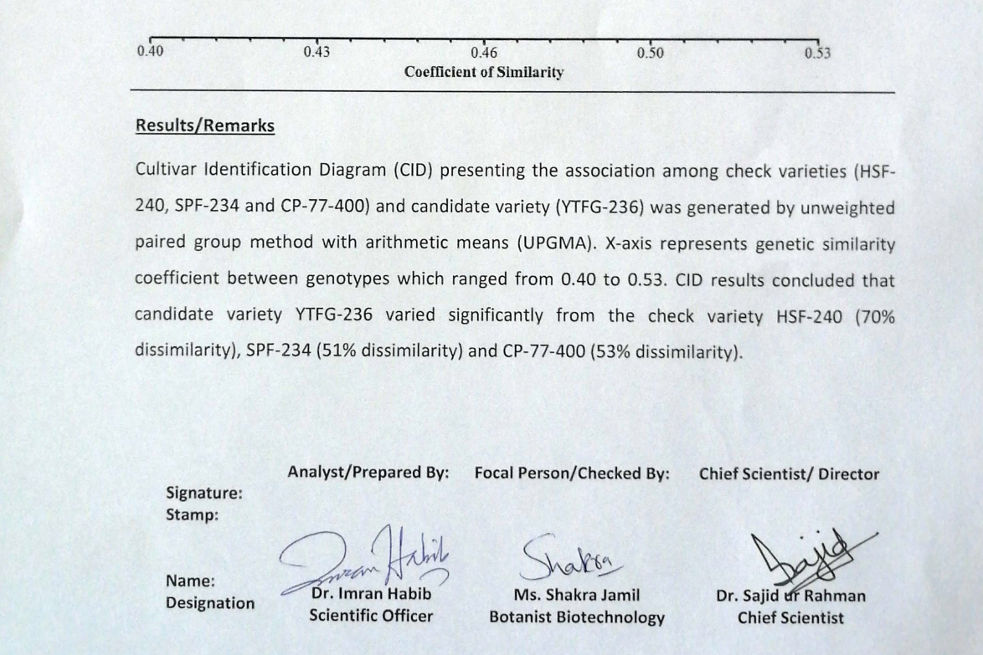
DNA Fingerprinting from Agri. Biotechnology Research Institute, AARI Faisalabad.

Slide 16
Results of Zonal Field Trials
(2019-2021)
Zonal field trails were conducted at 09 locations of Punjab during Spring 2019. Detail of locations is as under and results were taken in 3rd week of February.
Mr. Rao Yousaf Jamil, Moza Gurmani, FSML.
Mr. Syed Sajjad Hussain, Moza Tariq Chowk, Kot Addu
Mr. Chunnu Khan Laghari, Moza Jatoi, Muzaffargarh
Mr. Arshad Hussain Khan, Layyah
Mr. Fareed Hussain Bhapla, D. G. Khan
Mr. Malik Rab Nawaz Kalroo, Multan
Mr. Mushtaq Ahmad Baloch, Chowki Masti, Kehror Pakka, Lodhran
Mr. Langer Khan, 18 Hazari, Jhang

Slide 17
Summary of Zonal Field Trials
(Average of 02 years at harvesting in Feb.)
Variety | Cane Yield (tons/ha) | Recovery % | Sugar Yield (tons/ha)
YTFG-236 | 126.24 | 12.91 | 16.30
CPF-253 | 120.00 | 12.38 | 14.86
SPF-234 | 110.66 | 12.22 | 13.52
CPF-246 | 106.11 | 11.87 | 12.60
CPF-250 | 99.17 | 12.61 | 12.51
CPF-237 | 100.58 | 12.20 | 12.27
CPF-251 | 91.88 | 12.77 | 11.73
CP77-400 | 102.39 | 10.30 | 10.55
HSF-240 | 88.73 | 9.90 | 8.78

Slide 18
Detail of Cane Yield (tons/ha)
(Average of 02 years at harvesting in Feb.)
Variety | Sanawan | Kot Addu | Muzaffargarh | Layyah | D. G. Khan | Multan | Lodhran | Jhang | Average
YTFG-236 | 133.05 | 130.65 | 127.20 | 123.55 | 128.50 | 124.65 | 126.40 | 115.95 | 126.24
CPF-246 | 101.55 | 103.40 | 106.85 | 110.30 | 117.15 | 103.10 | 100.45 | - | 106.11
CPF-250 | 106.35 | 89.90 | 98.70 | 97.20 | 105.65 | 94.45 | 99.10 | 102.00 | 99.17
CPF-251 | 95.95 | 85.35 | 95.75 | 86.75 | 93.20 | 94.45 | 91.65 | 91.90 | 91.88
CPF-253 | 131.25 | 121.60 | 116.10 | 123.70 | - | 126.75 | 111.80 | 108.80 | 120.00
SPF-234 | 122.00 | - | 105.75 | - | 99.85 | - | 115.05 | - | 110.66
CPF-237 | 100.75 | 102.25 | 95.65 | 106.30 | - | 99.20 | 99.35 | - | 100.58
CP77-400 | 99.30 | 99.50 | 98.75 | 103.10 | 102.75 | 105.00 | 112.40 | 98.30 | 102.39
HSF-240 | 90.85 | 84.60 | 89.95 | 88.35 | 85.15 | 87.15 | 92.45 | 91.30 | 88.73

Slide 19
Detail of Recovery %
(Average of 02 years at harvesting in Feb.)
Variety | Sanawan | Kot Addu | Muzaffargarh | Layyah | D. G. Khan | Multan | Lodhran | Jhang | Average
YTFG-236 | 12.87 | 13.02 | 12.81 | 13.06 | 12.86 | 12.97 | 12.84 | 12.86 | 12.91
CPF-246 | 11.66 | 11.80 | 11.92 | 12.31 | 12.09 | 11.61 | 11.73 | - | 11.87
CPF-250 | 10.64 | 12.95 | 13.22 | 13.17 | 12.98 | 12.88 | 11.94 | 13.10 | 12.61
CPF-251 | 12.50 | 12.85 | 12.86 | 12.98 | 12.81 | 12.57 | 12.75 | 12.85 | 12.77
CPF-253 | 11.95 | 12.51 | 12.81 | 12.57 | - | 12.35 | 12.40 | 12.07 | 12.38
SPF-234 | 12.04 | - | 12.33 | - | 12.83 | - | 11.69 | - | 12.22
CPF-237 | 11.75 | 12.27 | 12.77 | 12.13 | - | 11.99 | 12.26 | - | 12.20
CP77-400 | 10.04 | 10.19 | 10.26 | 10.50 | 10.57 | 10.29 | 10.35 | 10.21 | 10.30
HSF-240 | 9.32 | 10.03 | 10.03 | 10.11 | 9.81 | 10.00 | 10.11 | 9.76 | 9.90

Slide 20
Quality Analysis of YTFG-236 from Different Institutes / Sugar Mills
Date | Institute | Recovery %
28-Sep-21 | Ashraf Sugar Mills. | 9.71
30-Dec-21 | SCRI, Mardan (Govt. of KPK). | 12.54
11-Jan-22 | SRI, AARI, Faisalabad (Govt of Punjab). | 12.04
28-Jan-22 | SCRI, Mardan (Govt. of KPK). | 12.38
01-Feb-22 | SRI, AARI, Faisalabad (Govt of Punjab). | 12.33
17-Feb-22 | RYK Sugar Mills. | 12.02
22-Feb-22 | Sheikhoo Sugar Mills. | 12.40
22-Feb-22 | Fatima Sugar Mills. | 12,68
21-Mar-22 | Analysed by Ramzan Sugar Mills Representative. | 13.33
29-Sep.22 | Darya Khan Sugar Mills, Darya Khan. | 8.98

Slide 21
Reaction of Promising lines Against Red Rot During 2017-2022 at FSRDC-FSML
Variety | Red Rot (2017) | Red Rot (2018) | Red Rot (2019) | Red Rot (2020) | Red Rot (2021) | Red Rot (2022)
YTFG-236 | R | R | R | R | R | R
CPF-250 | R | MR | MR | MR | MR | MR
CPF-253 | - | - | MR | MR | MR | MR
CPF-251 | MR | R | MR | MR | MR | MR
CP 77-400 | MR | MR | MR | MR | MR | MR
CPF 246 | MS | S | MS | S | MS | MS
CPF-247 | MS | MS | S | MS | MS | S
CPF-249 | MS | MS | S | S | S | S
HSF 240 | MR | MR | MR | MR | MR | MR
CPF-237 | MR | MR | MR | MR | MR | MR
SPF-234 | HS | HS | S | HS | HS | HS

Slide 22
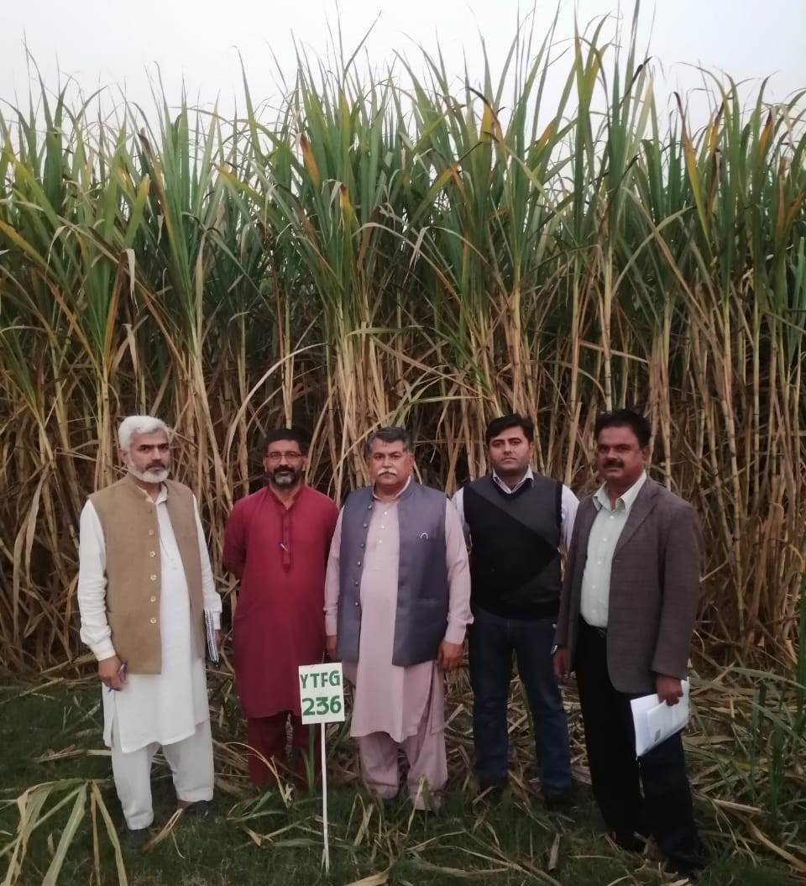
Visit of Sugarcane Travelling Seminar organized by PARC, Islamabad at FSRDC Research Farm

Slide 23
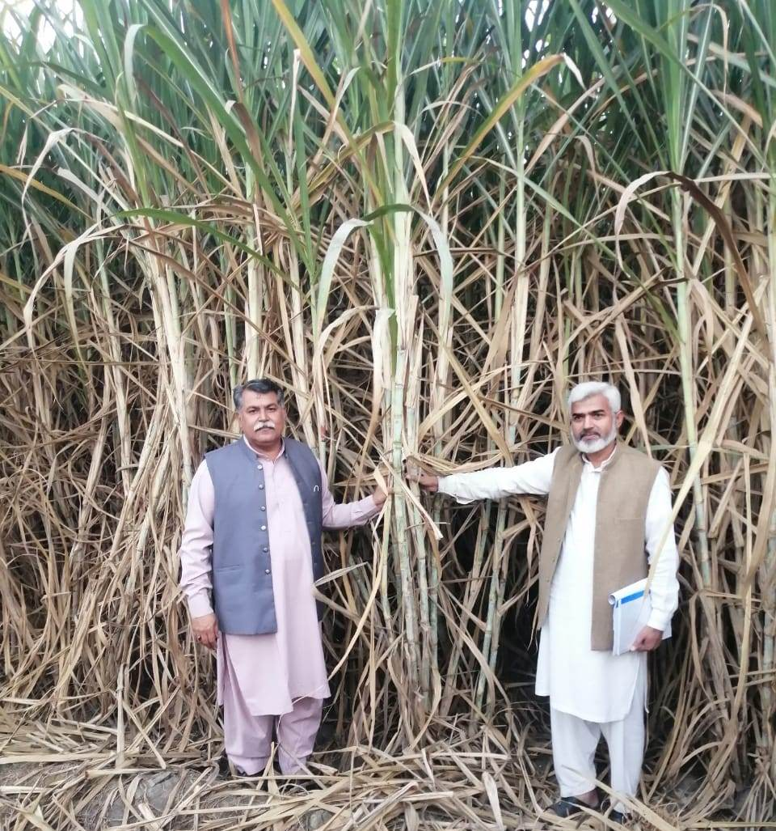
Visit of Sugarcane Travelling Seminar organized by PARC, Islamabad at FSRDC Research Farm
YTFG-236

Slide 24
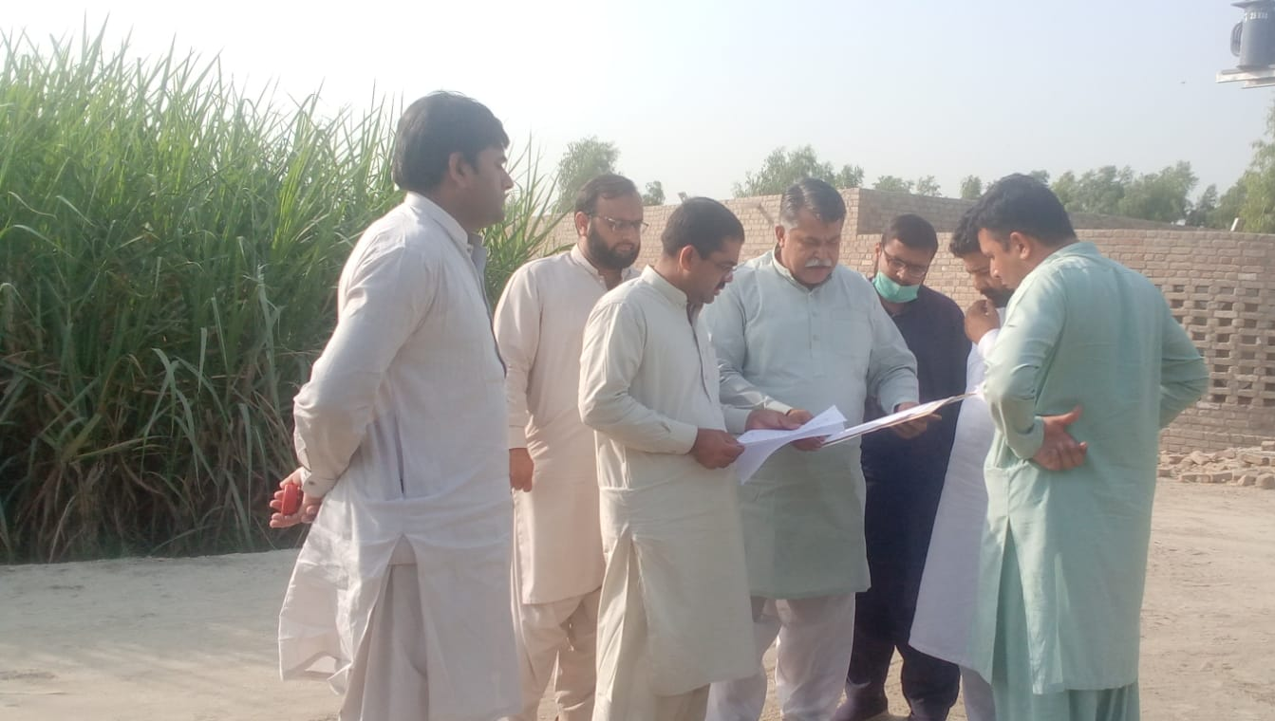
Inspection Visit of Federal Seed Certification & Registration Department, Islamabad at FSRDC Research Farm

Slide 25
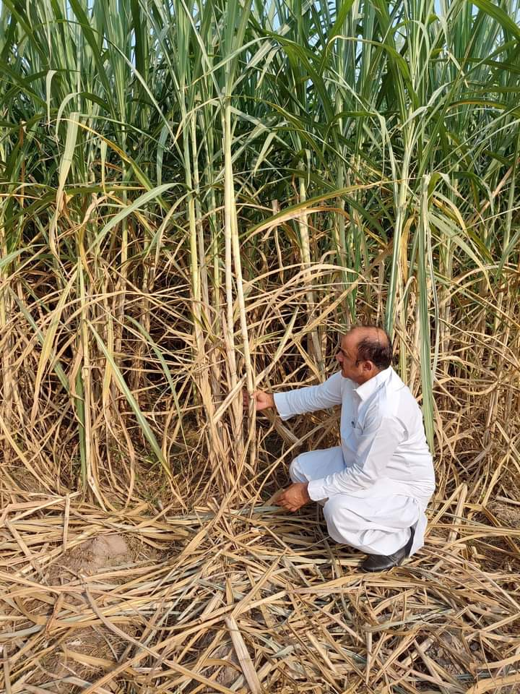
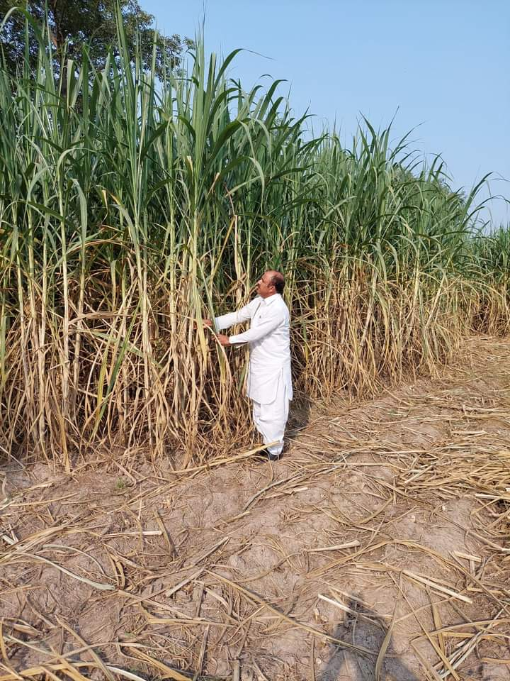
View of YTFG-236 at Ramzan Sugar Mills Farms September 2022

Slide 26
Thanks

