Slide 1
“LIARS AT WORK”
ORGANIZATIONAL OBSCURANTISM: SYNTHESIZING PROSOCIAL LIES WITH INTERPERSONAL RELATIONSHIP
AT WORKPLACE
Dr. Rashid Baloch
GM (HR& Admn)
Mehran Sugar Mills Limited Tando Allahyar

Slide 2
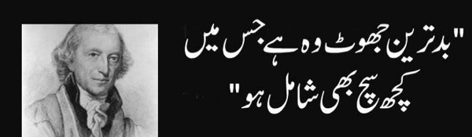
Organizational Obscurantism

Slide 3

What is lie?
In the workplace people fib, flatter, fabricate, prevaricate, and equivocate. They take liberties with, embellish, bend, and stretch the truth. They boast, conceal, falsify, omit, spread gossip, misinform, or cover up embarrassing (perhaps even unethical) acts.

Slide 4
Top Management Officers ’s Ethical Behaviors
Top management officers are not likely to allow their "ethics" to be directly observed or measured (Linda, 1986).
Top management officers’ ethical behavior will be influenced significantly by the demands of authority (Linda, 1986).
Top management officers' ethical behavior will be influenced negatively by external pressures of time, scarce resources, competition, or personal costs (Linda, 1986).
Linda, K., Trevino. (1986). Ethical Decision Making in Organizations: A Person-Situation Interactionist Model. Academy of Management Review., 11(3 ), 601-617.

Slide 5






Slide 6








Slide 7
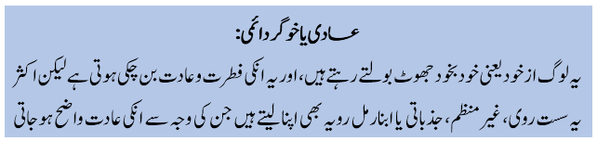
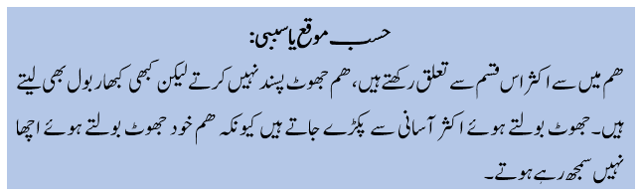

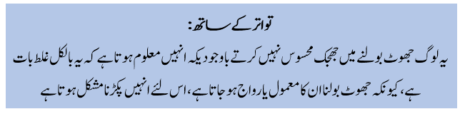
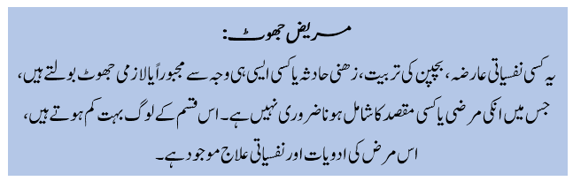

Slide 8















Slide 9








Slide 10






Slide 11











Slide 12





Slide 13










Slide 26

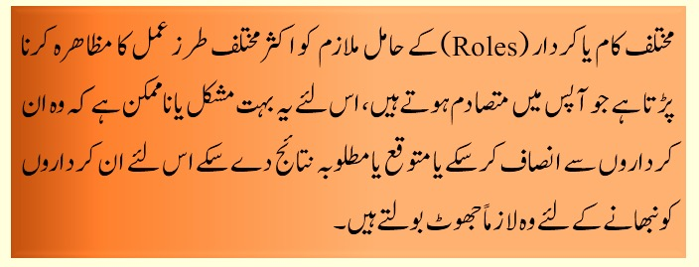
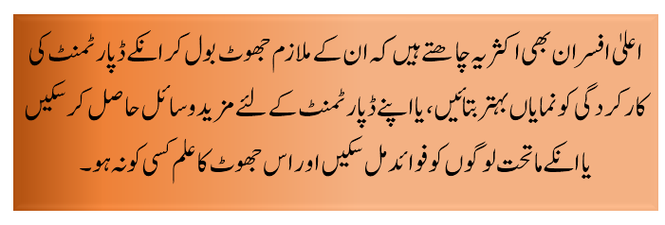

Slide 27
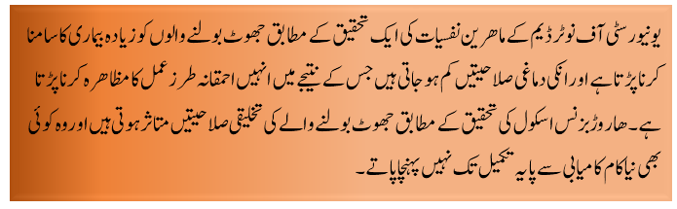

Slide 28

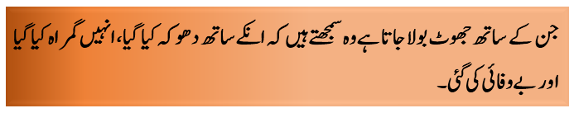

Slide 29
Reasons Employees lie to the boss
The boss can enhance or hinder your career track
The boss can control your salary
The boss argues with you when you tell them the truth
The boss violates confidence (Not keeping secrets)
The boss shoots the messenger (blaming the bearer of bad news) and the problem you point out becomes your problem

Slide 30
If you are the boss, people lie to you unless …
You honor those who disagree with you
You give opportunities to those who think otherwise
You stop hanging with brown nosers (Sycophants)
You keep asking questions that get to the bottom issues
You point out inconsistencies that seem like lies
People tell the boss what the boss wants to hear. If you don’t aggressively address this tendency, many will lie to you. It isn’t necessarily malicious. It’s more likely
SELF-SERVING.

Slide 31
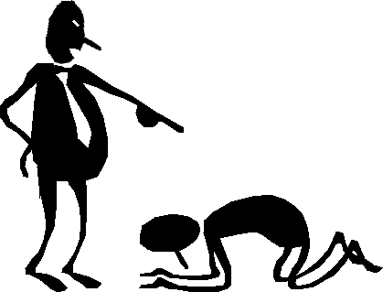
Believe me !
They lie because they’re under pressure to perform and because “they lack the guts to tell the boss that what is being asked isn’t doable.”

