Slide 1
ANNUAL PSST CONVENTION SEPTEMBER 12 – 13, 2011 LAHORE
Energy, Environment & Efficiency Measures of Bagasse fired boilers
Effective implementations at Faran Sugar Mills
By,
Mohammad Sarfaraz Khan
Technical Manager
Faran Sugar Mills Limited
Shaikh Bhirkio, District,
Tando Mohammad Khan, Sindh.
Notes:
<number>

Slide 2
Introduction
Faran Sugar Mills commissioned during 1983 with two bagasse-fired boilers (FCB design) having initial evaporation capacity of 34 TPH at 24Kg/cm2, 3300 C working parameters. Initially both boilers supplied with economizers as sole heat recovery equipment without air-heater and ash collecting arrangement. Later on, in order to meets the enhanced crushing capacity, induction of other boilers as 50 TPH (Yoshimine) and Takuma 80 TPH has been added in the battery towards the end of 2006.
In order to attain rated generation and efficiency, a road map was planned in 2009 to implement phase-wise efforts to enhance capacity within the existing design setup. Certain modifications/implementations were therefore carried out in the areas as follows,
Modification in boiler # 1 (FCB design under taken.
2
Notes:
<number>

Slide 3
Reasons for Modifying
Boiler is of FCB origin and has operated since 1983 for about 26 years. With passage of time, its capacity and efficiency was reduced considerably. Certain parts like economizer needed to be replaced due to its under rated out put. As aresult the temperature of out going gases was increased in stack between 300 – 310 oC.
Operational inconsistencies
Operating the boiler was a difficult exercise, because of heap firing of bagasse in the furnace instead of suspended combustion of the same. Furnace backing was also a problem for boiler and was a safety hazard for the operators on site.
3
Notes:
<number>

Slide 4
Non-availability of dust collector contributes
Ash particles were discharging from the stack and creating environmental problem. Besides eroding the areas enroute including, Economizer tubes, Ducting & ID Fan. This caused an involuntary violation of local EPA rules as well. One of the significant aspects of wearing reflects the amount of wear which is proportional to about 3.5th power of gas velocity which is in the range of 8 – 30 m/s.
4
Notes:
<number>

Slide 5
Modifications Carried Out during First phase (Off – season 2009)
Original boiler economizer has already been damaged which was repaires and replaced by a small economizer which was replaced with a newly designed economizer of suitable heating surface, Characteristics are as under,
Heating Surface 125 M2
Temperature of gases before Economizer 330 – 340 °C
Temperature of gases after Economizer 285 – 280 °C
Temperature of water before Economizer 95 – 98 °C
Temperature of water after Economizer 115 – 120 °C
Temperature Rise 20 – 22 °C
A new FCB- design air heater of appropriate specification has been designed and installed. Their characteristics are as follows,
Heating Surface 944 M2
Stack out going gas temperature before Air-heater 300 – 310 °C
Stack out going gas temperature after Air-heater 220 – 230 °C
Air heater out let air temperature 120 –130 °C
Ambient air temperature 25 – 30 °C
Temperature captured from gases 80 °C
5
Notes:
<number>

Slide 6
Five newly fabricated super heater coils were installed to raise its heating surface by 9 %. However, these were blocked previously. This activity also facilitated us to raise the temperature from 7 – 10 °C Consequently steam enthalpy raised the system efficiency & reliability also.
Ducting replaced to suit the new fans.
Dust collector arrangement design, fabricated and erected to meets the ash production disposal on 5 % based of fuel consumption at MCR. However, it is further translates to 772 Kg/hr of ash @ 15454 Kg/hr of bagasse consumption.
All draft fans (FD, SA and ID fan) were replaced after due modifications with new fans to bear the additional load with enhanced power as shown below:
6
Notes:
<number>

Slide 7
CHARACTERISTICS OF FAN & POWER ENHANCEMENT AT FCB BOILER # 1

Slide 8
Achievements during season 2009 – 10 at FCB Boiler # 1
Boiler thermal efficiency was increased by 9% from 73% to 82 %. Temperature of out going Gases was controlled between (183 - 220 oC) as against stack temperature of 300-310 oC
Overall efficiency has been increased by 11 % that is equal to 4T/Hr extra steam generation at no cost other than the design i.e. from 34 to38 Tons/hr
Operational difficulties have been overcome to certain extent. Boiler is operating smoothly, no backing and heap firing observed. Quality of flame is very good. Temperature is around 750 –800 oC
Dust collector is working excellently thereby proving the apex capacity of the installed equipment; one of the significant aspects observed was the quantity of ash carried over to stack is almost negligible which ultimately is eco-friendly.
Inspite of 208 KW excess power consumption, we have attained an extra 4 TPH steam at no cost. Bagasse consumption has also reduced due to increase in thermal efficiency.
8
Notes:
<number>

Slide 9
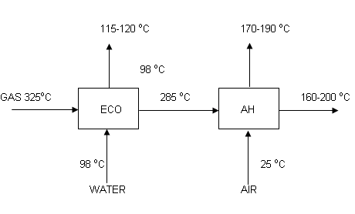
Modifications Carried Out during 2nd phase (Off – season 2010)
During 2nd phase we have inducted three economizers at boiler # 2(FCB), Boiler # 3 (Yoshimine) and boiler # 4 (Takuma). Their operational and targeted characteristics are as follows for performance assessment:-
Targeted Figures for Economizers
9
Notes:
<number>

Slide 10
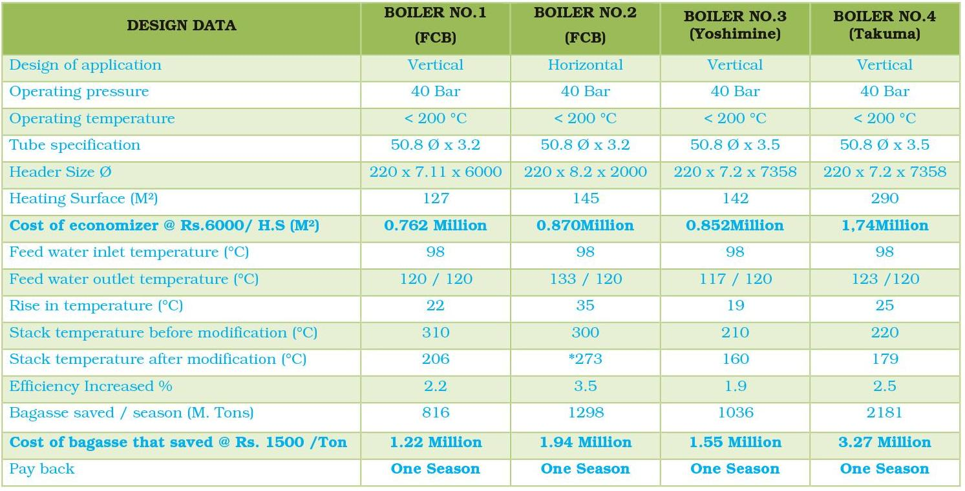
Achieve Figures of Entire Economizers during season 2009 –10
CHARACTERISTIC OF INSTALLED ECONOMIZER AT FARAN SUGAR MILL BOILERS
* Boiler No.2 is still on original design i.e. without air heater & ash collector. However, we’ve enhanced the heating surface of existing economizer during season 2010-11. Additionally, primary air heated up to 110 °C against ambient to the original design to attain efficiency.
Cost of economizer Rs.6,000 / M² Heating Surface (Material Plus Labour)
Pay back with in season (Achieved)
10
Notes:
<number>

Slide 11
(Economizer Cost Vs Payback Graphical presentation)
11
Notes:
<number>

Slide 12
12
Notes:
<number>

Slide 13
13
Notes:
<number>

Slide 14
REPLACEMENT OF ID FANS
CHARACTERISTICS OF ID FANS
STEAM PRODUCTION ENHANCEMENT AFTER MODIFICATION
CHARACTERISTICS OF CAPACITY
14
Notes:
<number>

Slide 15
PROVISION OF HOT AIR DUCT FROM FCB BOILER # 1 TO
FCB BOILER # 2
Boiler # 2 (FCB) was designed to provide ambient air to furnace with secondary ducting too. This contributed poor thermal efficiency to the combustion. In order to attain better efficiency, a duct was introduced from Boiler # 1 FCB air heater out let to utilise excess fan capacity. This activity enhances primary air temperature up to 110 OC from ambient temperature. Due to improvement in combustion thermal efficiency enhanced up to 4%.
1780 M. tons bagasse saved
Payback within season 2.67 million @ Rs.1500/ton bagasse
15
Notes:
<number>

Slide 16
An investment Vs pay back graph is as under for productivity assessment
16
Notes:
<number>

Slide 17
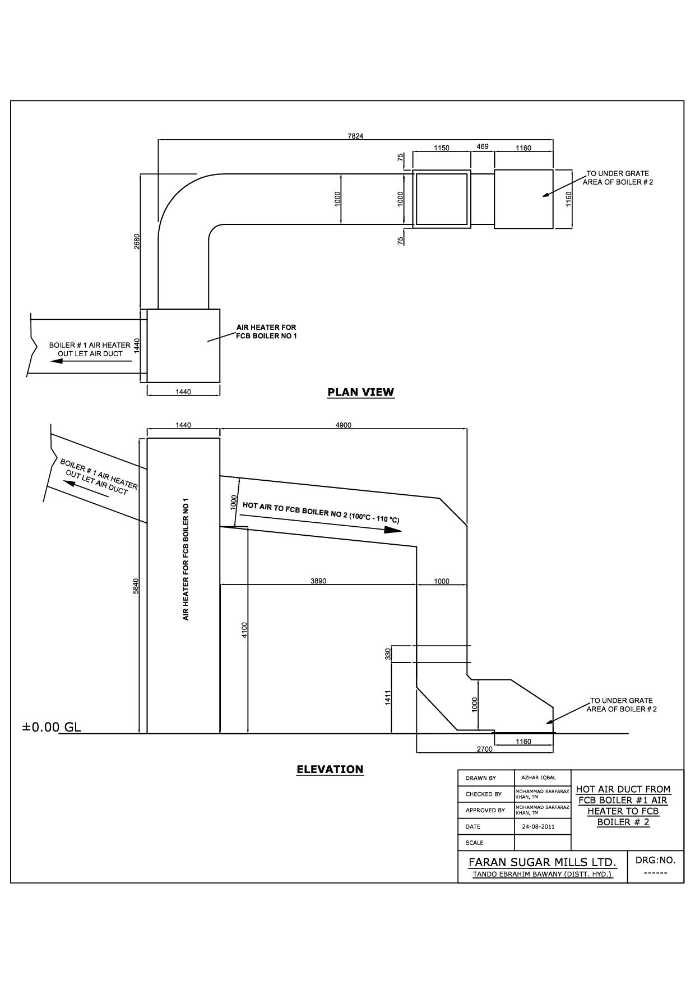
HOT AIR DUCT FROM FCB BOILER # 1 TO FCB BOILER # 2
17
Notes:
<number>

Slide 18
Steam Purification and quality
Generally, in our systems,the steam produced is supplied directly from boiler to the distribution header without any further dryness. This happens with Takuma, Yoshimine and Backau – Wolf boilers.
As observed on most of the plants, steam quality is not ensured due to boilers of different operating parameters (variation in Pressure & Temperature). The quality of steam remains available with average enthalpy contents that is contributing in reduction in efficiency.
We have experienced frequency of carry over in the past especially from HMC design (Takuma) boiler of 80 TPH capacity. After assessment it has been observed that drum internal integrals becomes in- efficient and steam generated directly moves to steam distribution header as per their design. The quality of steam sufferes when boiler load reaches to the rated capacity.
18
Notes:
<number>

Slide 19
MESH DEMISTER PAD
In order to explore solution due to capacity enhancement, Mesh demister was imported from abroad for steam drums internals to trap the suspended liquid particles up to 3 – 5 µm. Additionally a steam separator of FCB design was introduced in the steam distribution system to ensure steam quality before going to the steam turbines.
(Cost of Mesh Demister pad Rs.70, 000/=)
19
Notes:
<number>

Slide 20
Temperature reduction
Shown in figure below, is a typical FCB design steam separator which has capacity to produce quality steam. Due to its typical internal arrangement, the pressure drop is negligible and dryness ensured. Subsequently, the prime movers efficiency is improved and consumption considerably reduced due to improved stable enthalpy contents.
After induction of the said arrangement temperature rose up to 7 – 10 OC resulting in improved in enthalpy contents which in turns improved turbine efficiency with added steam quality. Combination of entire arrangement from drum to steam separator prior to steam distributing header is as follows:-
20
Notes:
<number>

Slide 21
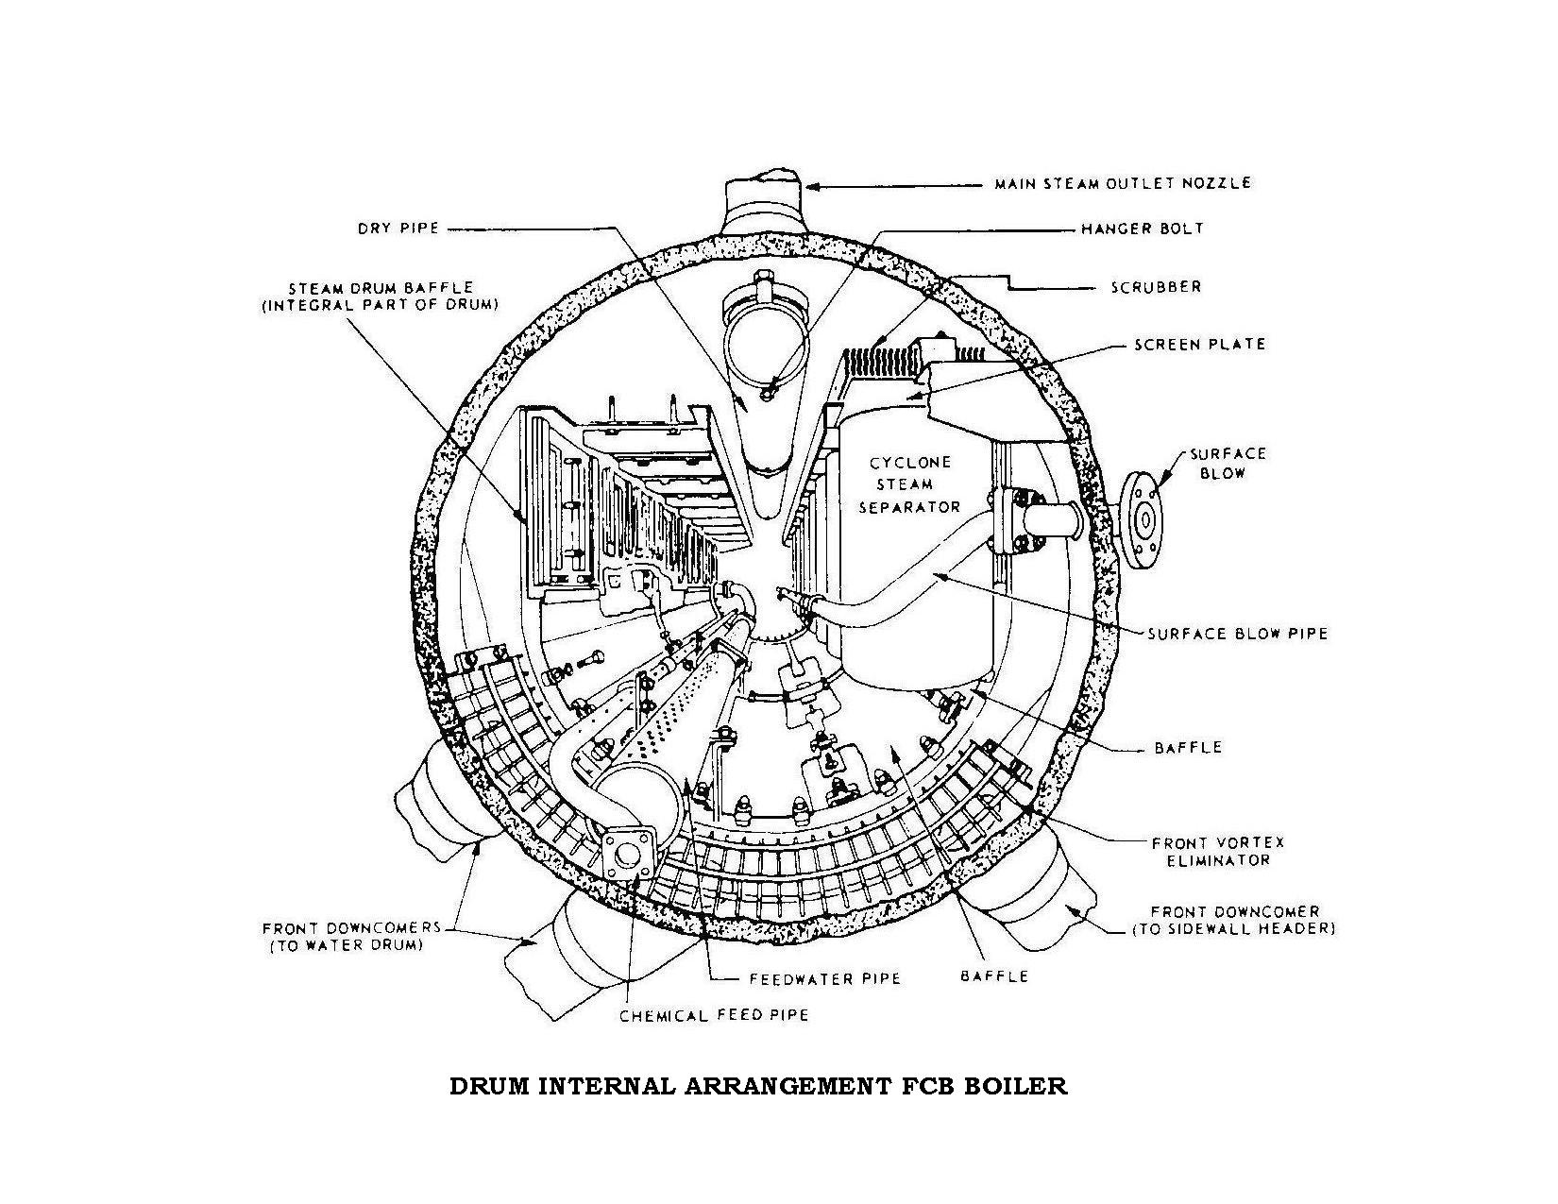
DRUM INTERNAL ARRANGEMENT FCB BOILER
21
Notes:
<number>

Slide 22
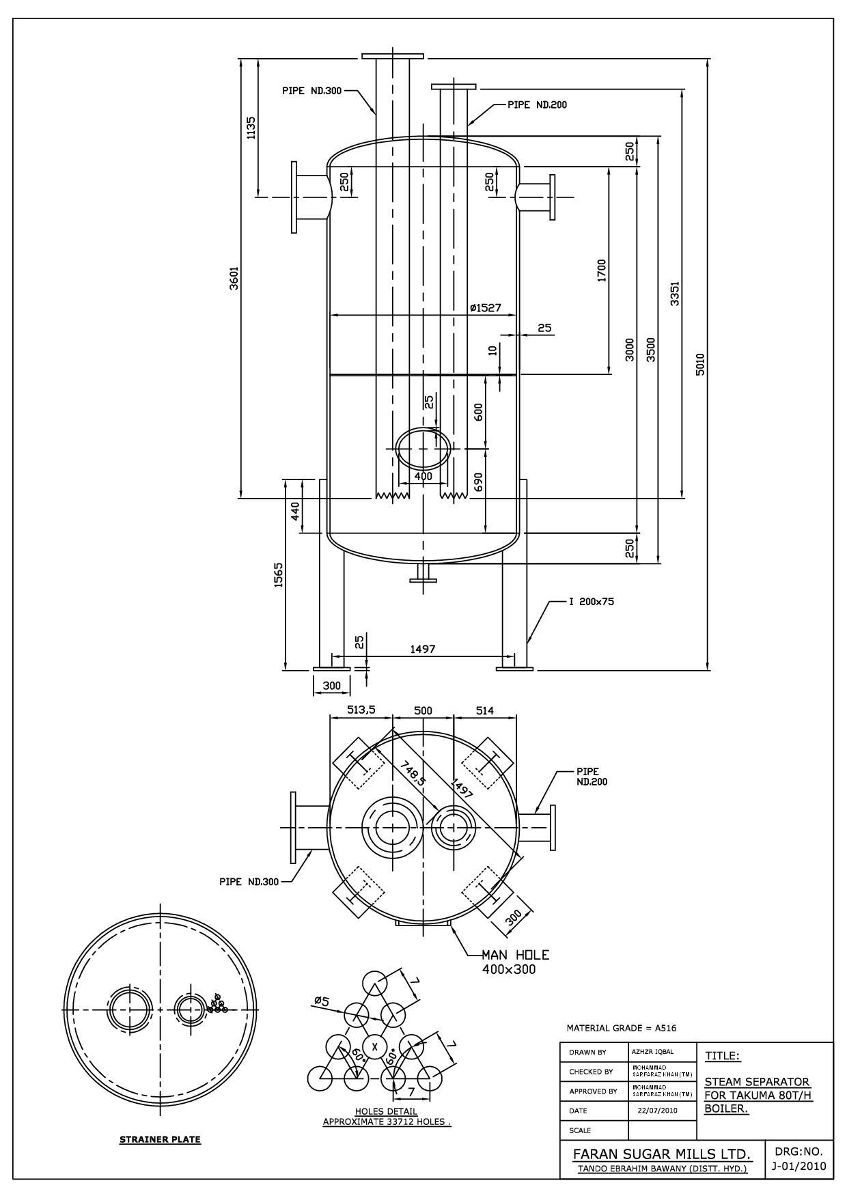
FCB DESIGN STEAM SEPARATOR
22
Notes:
<number>

Slide 23
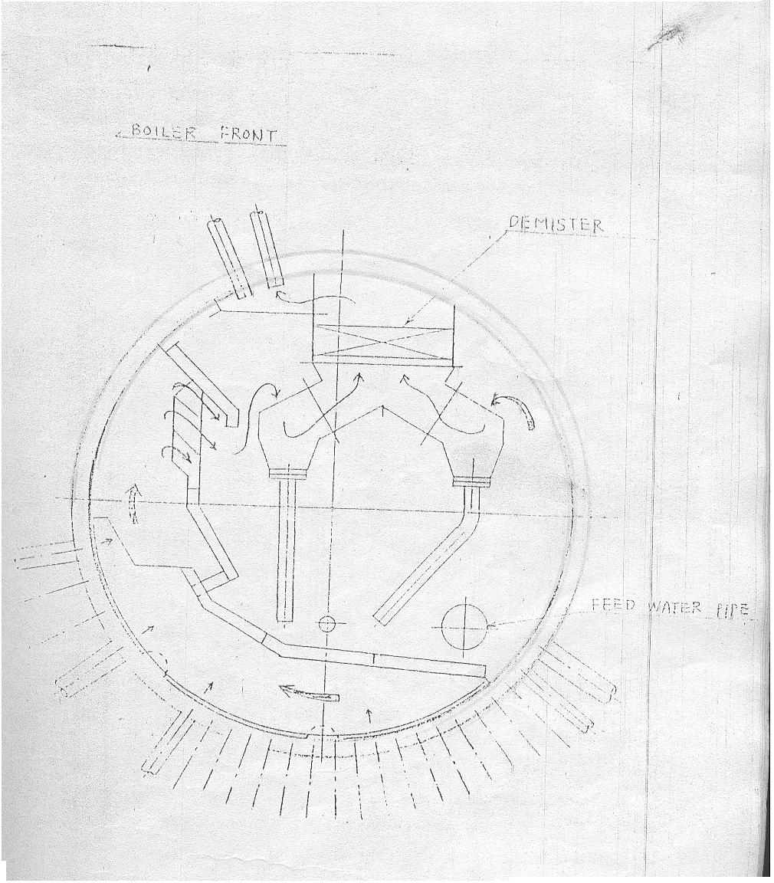
INTERNAL ARRANGEMENT FOR TAKUMA BOILER NO.4 FOR COMPARISON WITH FCB DESIGN ARRANGEMENT
23
Notes:
<number>

Slide 24
Acknowledgement
I am thankful to the management of Faran Sugar Mills to provide me with an opportunity to present this Technical Paper here at PSST annual convention 2011.
24
Notes:
<number>

Slide 25
References
Power Plant Technology by R.K.Jain
Steam Purification system
FCB Manual for bagasse fired boilers (34 – 45 TPH Boilers)
Design documents for up grading from 34 to 38 TPH FCB boiler
25
Notes:
<number>

Slide 26
THANK YOU
Notes:
<number>

